Slide 1

A Model for Reunification:
a Lighthouse in the Stormy Waters of Post-Separation
Presenters: Cecily Walker and Lylia Pham
Presentation authored by the “Our Kids” Parenting Orders Program Team at CatholicCare Metropolitan Melbourne

Slide 2
ACKNOWLEDGEMENT AND THANKS
The CatholicCare POP team would like to acknowledge and thank Dr Jenn McIntosh for her invaluable support in providing supervision and professional development to our team from 2009 to 2014. In particular the training she provided in the specific use of the Adult Attachment Interview and Experiences of Caregiving Interview have laid the foundations for much of our work. Her patient and incisive guidance has supported our work with post-separation families and it forms the basis for the work presented today. As our team evolves, we continue to draw on the knowledge and skills gained from Jenn in our daily practice.

Slide 3
ABOUT THE PROGRAM
Parenting Orders Program Team – CatholicCare Footscray and Epping office
Many clients mandated by family court following divorce or separation
Working with whole families where possible
Child inclusive practice is part of our work
Reunification is one aspect of our work
One case presented today as an example of our model – not all aspects covered today

Slide 4
DEFINITIONS AND TERMINOLOGY
Reunification – our context:
after separation, where a child who has had no contact with one parent for a period of time is to re-connect with the absent parent, usually court ordered
High conflict system – child often aligned with one parent
Reunification synonymous with: reconnection, re-introduction and sometimes referring to ‘introduction’
Case presented today resulted in a reunification, not all cases do

Slide 5
WHO IS INVOLVED?
The Child – all ages and stages, stuck in the middle, divided loyalties, protective of parents’ feelings, confusion, fear, anger, sadness …
The ‘Lives-with’ Parent – frequently anxious, (over)protective? and blaming of and holding a fixed image of the other parent’s capacity
The ‘Rejected’/’Absent’ Parent – frequently feels victimised, and desperate for the process to proceed, also blaming of the other parent
Other members of the family often involved …

Slide 6
THEORETICAL BACKGROUND
Work based on a combination of theories/concepts:
Attachment theory, particularly in the post-separation context
Neuroscience relating to trauma (attachment-related)
Family Systems approach – working with individuals remaining mindful of the dynamics within the family system
Child Development in the context of impact of separation on children’s development

Slide 7
THEORETICAL BACKGROUND
Practice is informed by a range of theories, research and techniques, including
Grief and Loss
Narrative Therapy
Conflict Management
Emotional Regulation
Strengths Based Approach
Theoretical approaches inform practitioners re:
Readiness & suitability of the child and parents for reunification
Pace of the process
Risk assessment and avoidance of harm

Slide 8
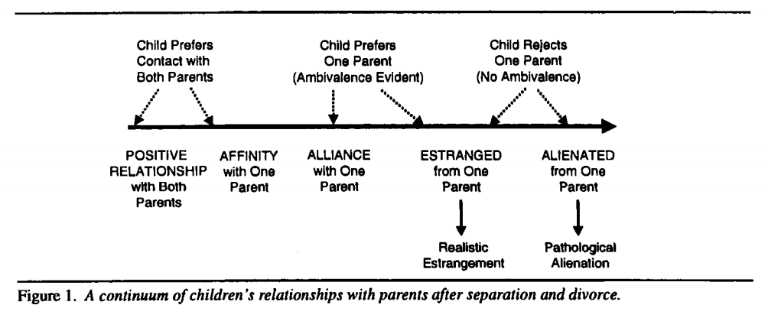
THEORETICAL BACKGROUND
Important to have an understanding of the concepts of alienation and estrangement – on-going debate
Using Kelly and Johnston’s (2001) reformulation of the ‘alienated child’ rather than ‘parental alienation’ to aid assessment
(Kelly & Johnston, 2001)

Slide 9
THE PROCESS
Assessment (ongoing)
Working therapeutically with each parent
Meeting and working with the child
Reintroduction
Planning for next steps
Closing
(Note) - Not a linear process

Slide 10
ASSESSMENT
Ongoing assessment
Risk assessment – family violence, mental health
Assessment/therapeutic tools:
POP Intake and Assessment processes
Adult Attachment Interview
Caregivers Interview
Child Attachment Interview
Child Inclusive Practice/Child consultation

Slide 11
ASSESSMENT
Assess
Reflective capacity of the parents. Can they:
Hold other perspectives?
Hold ambivalence/uncertainty?
Hold/appreciate the perspective of the child?
Child’s readiness
Co-working – Engagement of/with internal and external professionals and services

Slide 12
CORE INTERVENTION
Helping parents:
Relate their narratives around attachment experiences
Link their learnt patterns of relating to their caregiving
Identify and build on their parenting strengths, and enhance parental capacity
Identify the importance of the other parent to the child
Trust the process

Slide 13
CORE INTERVENTION
Helping the child:
Express and clarify emotions
Explore secrets and confusions
Navigate and build a new connection with the absent parent
Stay connected to the parent they live with
Trust the process

Slide 14
THERAPEUTIC RELATIONSHIPS
Importance of the therapeutic relationship to:
- Build parents’ and child’s trust in therapist and the process
- Hold all clients’ grief, fears & rage
- Educate around child-focus and value of both parents
Time for:
- Reflection, reading
- Supervision
- Self care
Practitioner
Ongoing assessment of readiness/capacity
Parent (Lives with)
Parent (to be reunited)
CHILD
Keep in mind:
- Reunification may not occur
- What happens next?

Slide 15
THE PROCESS
Family Counselling

Slide 16
CASE PRESENTATION

Slide 17
THE JOURNEY OF REUNIFICATION

Slide 18

DISCUSSION
Challenges and Ethical dilemmas
Am I doing no harm?
Whose orders?
Do I have the capacity to do this?
How much responsibility do I have after the reunification has happened?
Language and culture
Dealing with other professionals and legal constraints
Questions and Comments

Slide 19
REFERENCES
Baker, A. J. L. & Sauber, S.R. (Eds.). (2013). Working with alienated children and families: A clinical guidebook. New York: Routledge.
Fidler, B.J., & Bala, N. (2010). Children resisting post separation contact with a parent: Concepts, controversies, and conundrums. Family Court Review, 48(1), 10-47.
Garber, B.D. (2004). Parental alienation in light of attachment theory: Consideration of the broader implications for child development, clinical practice, and forensic process. Journal of Child Custody, 1(4), 49-76.
*George, C., Kaplan, N. & Main, M. (1985). Adult attachment interview. Unpublished manuscript, Department of Psychology, University of California, Berkeley (3rd Ed.). Retrieved from: http://www.psychology.sunysb.edu/attachment/measures/content/aai_interview.pdf
*Solomon, J. & George, C. (2007). Experiences of caregiving interview.
George, C., & Solomon, J. (2008). The caregiving system: A behavioral systems approach to parenting. In J. Cassidy & P. R. Shaver (Eds.), Handbook of attachment: Theory, research, and clinical applications (2nd ed., pp. 833-856). New York, NY: Guilford Press.
Hesse, E. (2008). The Adult Attachment Interview: Protocol, method of analysis, and empirical studies. In J. Cassidy & P. R. Shaver (Eds.), Handbook of attachment: Theory, research, and clinical applications (pp. 552-598). New York: Guilford Press.

Slide 20
REFERENCES
Johnston, J., Roseby, V., & Kuehnle, K. (2009). In the name of the child: A developmental approach to understanding and helping children of conflicted and violent divorce (2nd ed.). New York: Springer Publishing Company.
Kelly, J.B., & Johnston, J.R. (2001). The Alienated Child: A reformulation of parental alienation syndrome. Family Court Review, 39(3), 249-266.
*Shmueli-Goetz, Y., Target, M., Fonagy, P., & Datta, A. (2008). The child attachment Interview: A psychometric study of reliability and discriminant validity.” Developmental Psychology, 44(4), 939-956.
Smith, L.S. (2016). Family-based therapy for parent-child reunification. Journal of Clinical Psychology, 72(5), 498-512.
Smyth, B., Kelaher, M., McIntosh, J., Long, C., Wells, Y. (2010). Post-separation parenting arrangements: Patterns and developmental outcomes: Studies of two risk groups. Family Matters, 86, 40-48.
*Please note these inventories are only to be reproduced and/or used with permission of the authors

