Slide 1
How therapeutic can a CIP be?
An integrated model for family therapy post separation style
Lisa Robinson and Jessica Sadler
The Anchor, Uniting Counselling and Mediation, Unifam

Slide 2
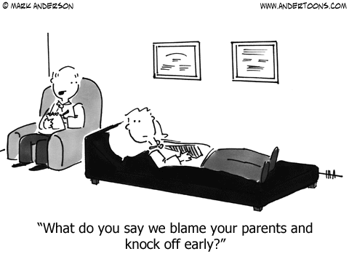

Slide 3
Articulating our model
Meeting with the child
Crafting the feedback
Delivering the feedback
Implementing the Recommendations
Therapy with the child
Parent Child relational repair

Slide 4
Contributions of
Systemic Family Therapy
Curiosity- Neutrality-Circularity
Hypothesising
Positive Connotation of intent
Reframing and metaphors
Other oriented mindfulness
Tracking Relationships over time
Family of Origin patterns
Behavioural sequences
Sub system boundaries & coalitions

Slide 5

What is Family Counselling under the Family Law Act?
http://www.google.com.au/u

Slide 6
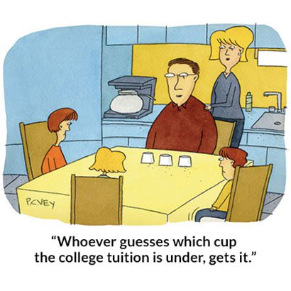
It’s about the children

Slide 7
Factors predicting outcome
Inter parental Relationship
Parent Child Relationship
Economic factors
Michael Lamb, 2002
  Exposure to interparental conflict
  The quality of the parent-child relationship
  Jen McIntosh, 2003
  Parent Child Connectedness (PCC) is a “super protective factor”
  ETR, 2004

Slide 8
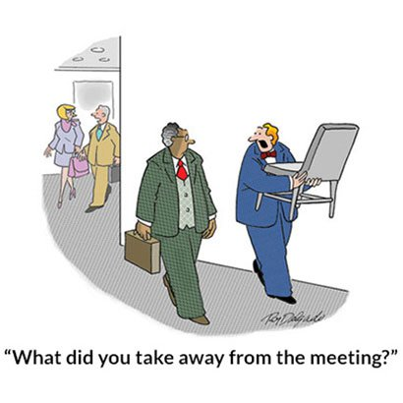
Parental Reflectivity

Slide 9
1. Meeting with the child
5 levels of assessment
Safety
FDR Agenda
Child Wellbeing
Relational Assessment
Intervention Needs

Slide 10
How can one meeting be therapeutic?
In summary it is a clinical assessment of how the child is thinking and feeling about the separation, and ultimately it is about understanding the impact of the separation, the level of conflict the child is exposed to, the child's relationships with the family and how the child is travelling.

Slide 11
2. Crafting the feedback
“ ….if I had known how difficult it was to have parents I never would have had any….”
12 year old

Slide 12
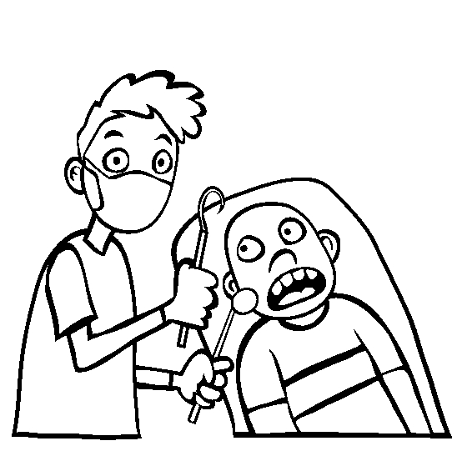
3. Feedback processes
This isn't going to hurt a bit

Slide 13
4. Implementing Recommendations
The work of the Adult consultants
The 6 C’S
Contract for the work
Practitioners have a shared agenda
Feedbacks and Ongoing work

Slide 14
5. Therapy with Child
Indicators for Therapy
6 Stages of separation – Judith Wallerstein
Core Developmental Tasks and Developmental Deficits – Janet Johnson
Therapeutic case plan – The Anchor

Slide 15
Six Tasks of Adjustment
Acknowledge the reality of the Separation
Disengage from parental conflict and distress and resume customary pursuits
Resolve their loss
Resolve Anger and Self Blame
Accept the permanence of the separation
Achieve realistic hope regarding the separation
Judith Wallerstein

Slide 16
Children’s Central Concerns
How do I keep myself safe?
How do I keep life predictable?
How do I stop the fighting?
How do I keep my parents safe?
Janet Johnson, 2005

Slide 17
Developmental Deficits
Hypervigilance, distrust and self reliance
Constriction of feelings, difficulty modulating affect and tolerating ambivalence
Low egocentricity and self efficacy, poor interpersonal boundaries
Overly simplified, rigid and distorted views of people
Harsh rigid rules of conduct, condemnation of self and others, failure to hope and dream

Slide 18
Therapeutic goals
Create Common ground and safety
Explore the language and complexity of feelings
Defining and understanding the self
Defining and revising roles and relationships
Restoring a moral order
Janet Johnson, 2005

Slide 19
Therapeutic Case Plan
Child’s ability to manage in their new family system, to understand the separation and to have any intense emotions validated and heard by parents
Individuation from parental distress/ needs and protection from parental conflict:
Child’s relationship with their parents and significant adults is supported where appropriate

Slide 20
6. Parent Child Relationship
Regular feedback with consultants
Working with Apologies
Separation Story – Trauma integration
Parental Attunement
Dyadic Attachment work
Integrative Play Therapy approach

Slide 21
Over to you Jess

Slide 22

Penny, Rachel and David
http://intranet/brand/Pages/default.aspx
http://intranet/brand/Pages/default.aspx
T: 8y
Rachel
T: 3y S:10y
David
Michael
4
2
Penny 11yrs

Slide 23
Flowchart of the Work
Supervision
Supervision
Supervision
Supervision
Case mtg
FEEDBACK
Case mtg
CHILD CONSULT
Supervision
Case mtg
FDR: Initiated by Father
Supervision
Supervision
Case mtg
Supervision
Case mtg
CHILD WORK
ADULT WORK
Supervision
Case mtg
Supervision
Case mtg
ONGOING FEEDBACK
Supervision
Supervision

Slide 24
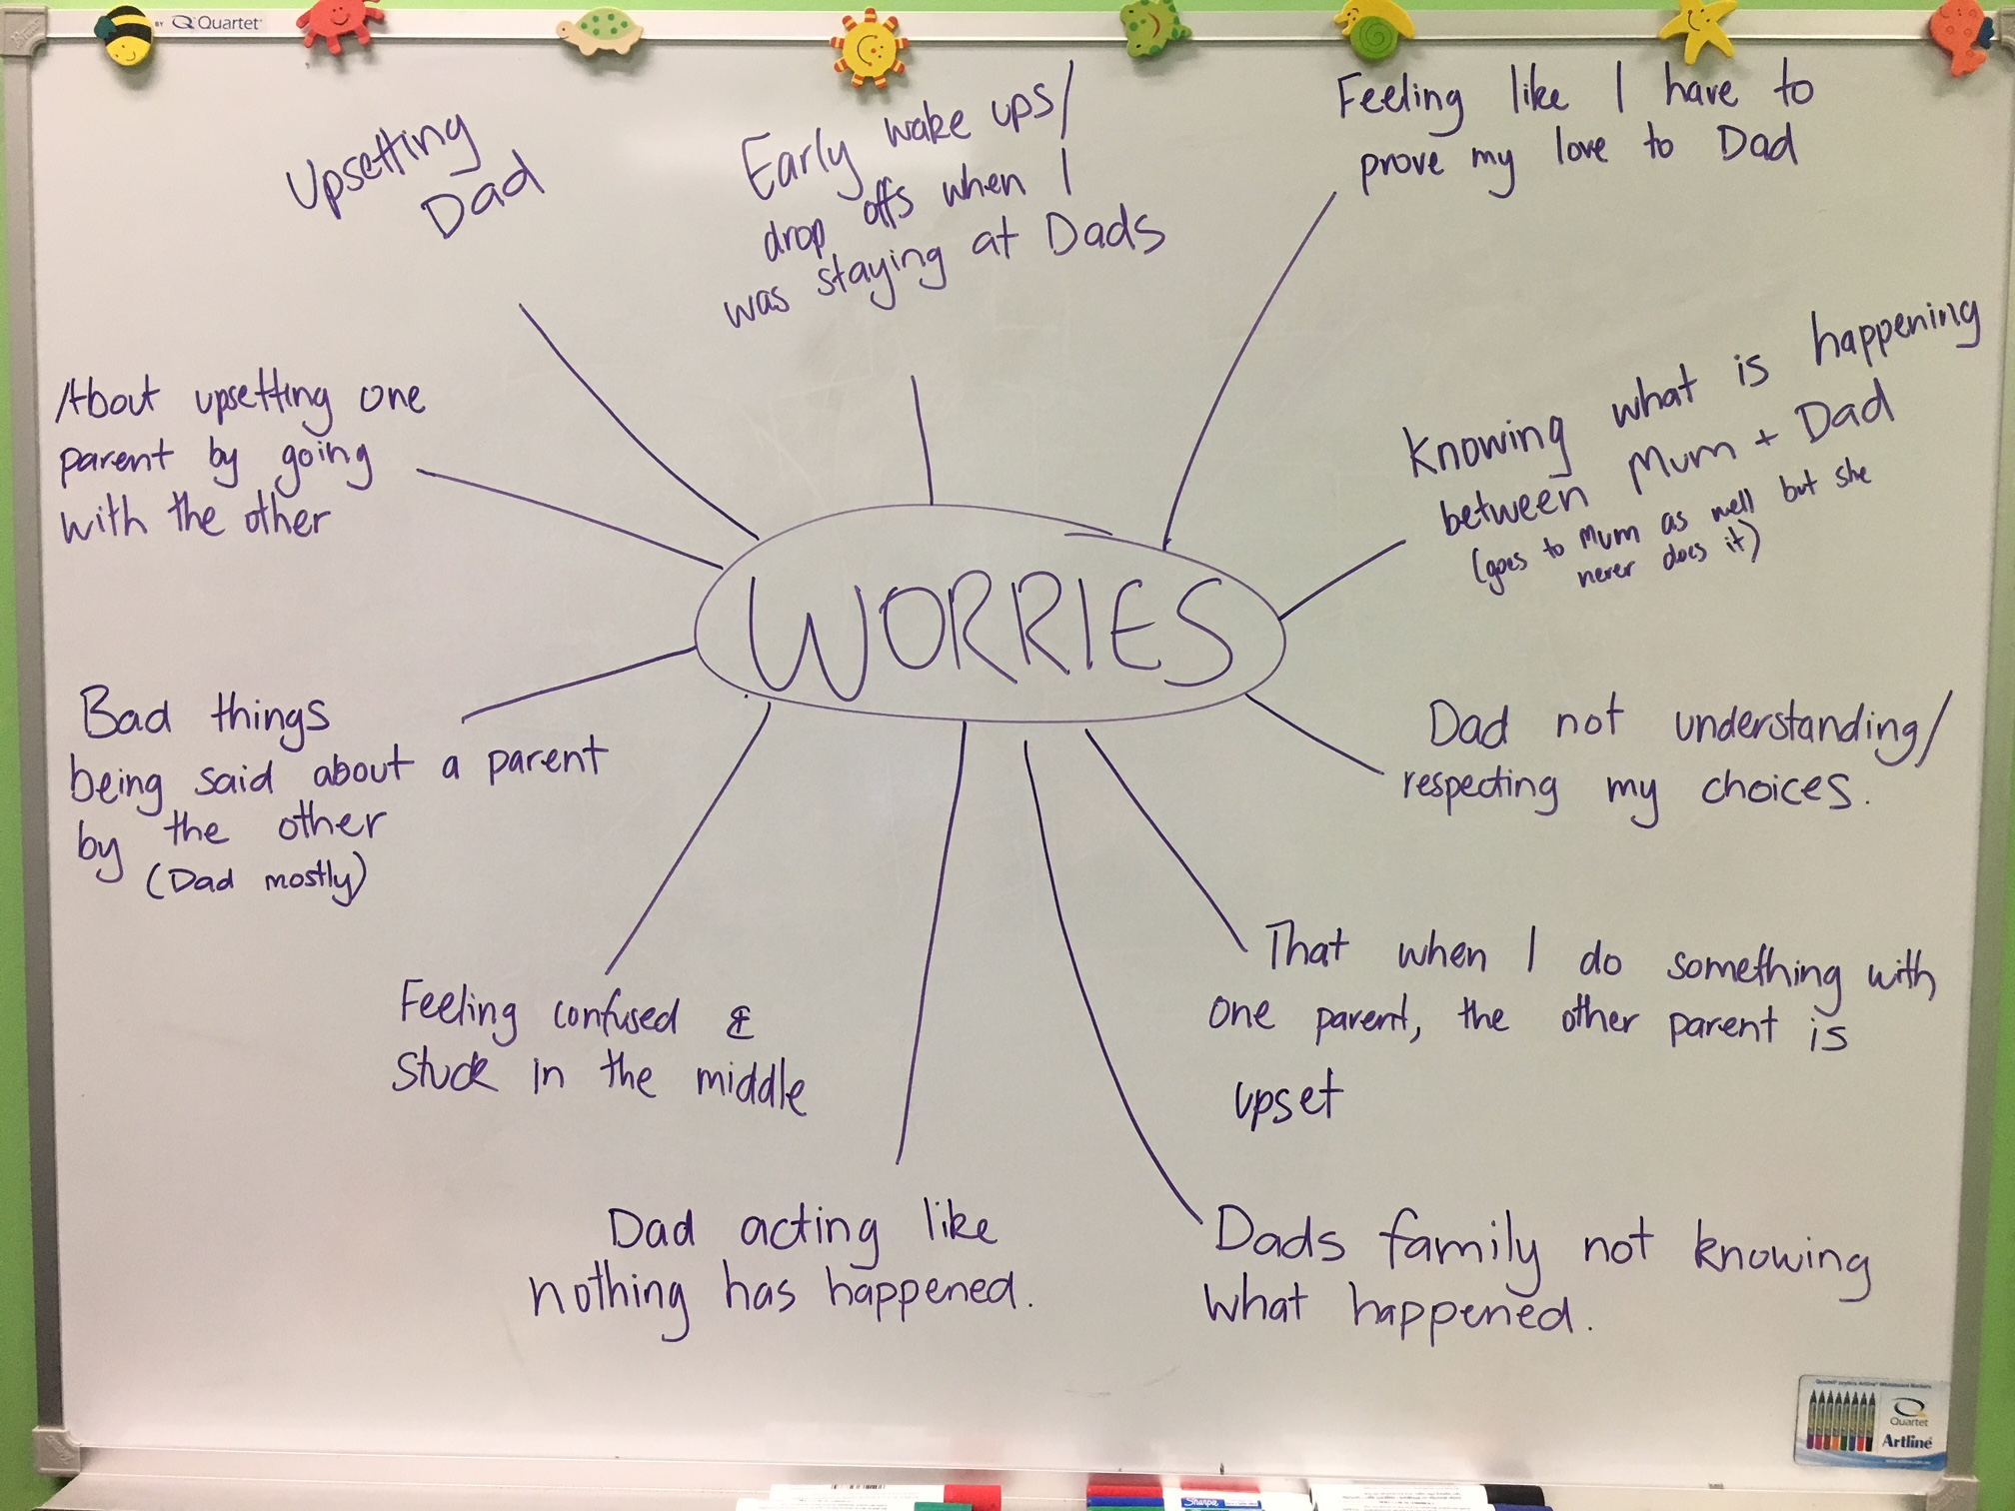
Meeting with the child
Presentation
Interventions: Genogram, likes/dislikes, worries mind map
Things she said:
“I want to be able to go to one house and know that the other parent understands”
“I don’t want to know what is happening between Mum and Dad anymore”
“He gets upset when I ask things he doesn’t like, like calling Mum. Then I feel responsible for upsetting him”
Indicators of distress

Slide 25
Initial Feedback
Themes:
David: Parental attunement, parentified emotional dysregulation, exposure to conflict / adult issues, apology,
Rachel: True Permission, parental attunement, exposure to conflict/ adult issue
Recommendations:
David: Adult work, minimising exposure to conflict / adult issue, Apology / acknowledgement letter.
Rachel: Adult work, achieving true permission, minimising exposure to conflict/adult issue
Penny: attend The Anchor

Slide 26
Adult work – Implementing recommendations
Letter from David to Penny:
Wow, it seems like forever since I’ve seen you and I miss you. I’m not sure how all this happened, I just know it hurts and I know it’s not your fault, things just happen. I’m sorry that I’ve contributed to where we are.
I understand that sometimes it must be hard for you thinking that you have to keep both Mum and I happy. We both love you lots and want the absolute best for you.
I am currently having counselling sessions with a colleague of Jesse. Her name is Ali, she too is great and she is assisting me in becoming the best Dad for you I can possibly be. She is helping to consider your needs, be bigger, stronger, wiser and kind in all aspects of my life. I am committed and ready to change anything we need to reunite us. I know you are growing up and will respect you and trust in your ideas in this journey.

Slide 27
5. Child Work
The ongoing therapeutic work centered around key themes:
Relational repair with Father
Individuation/Loyalty binds
Separating self from conflict
Response from Penny to David:
I know it’s been a while and I wish it never happened but I’m happy it has to solve the problems from the past. Thank you for acknowledging that it’s happened and your willingness to change.
Thank you for realising that I love both you and Mum and that I don’t want to be in the middle. Also I want you to know that I’m not just staying at Mum’s because I love her more, I’m staying there because I feel safe while we work this out.

Slide 28
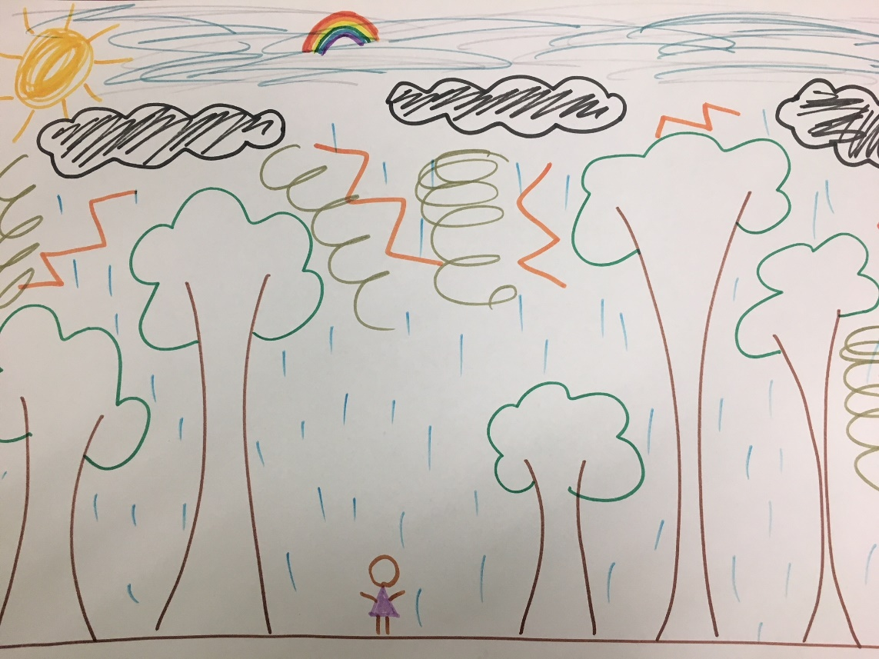

Slide 29
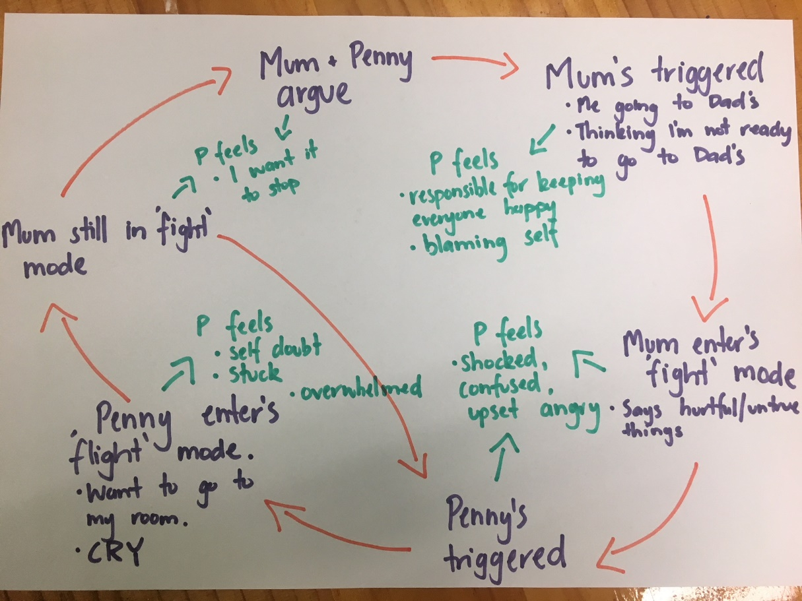
5. Child work cont….
Parent child relational healing
Bringing the parent in to the room
Ongoing feedback to parents

Slide 30
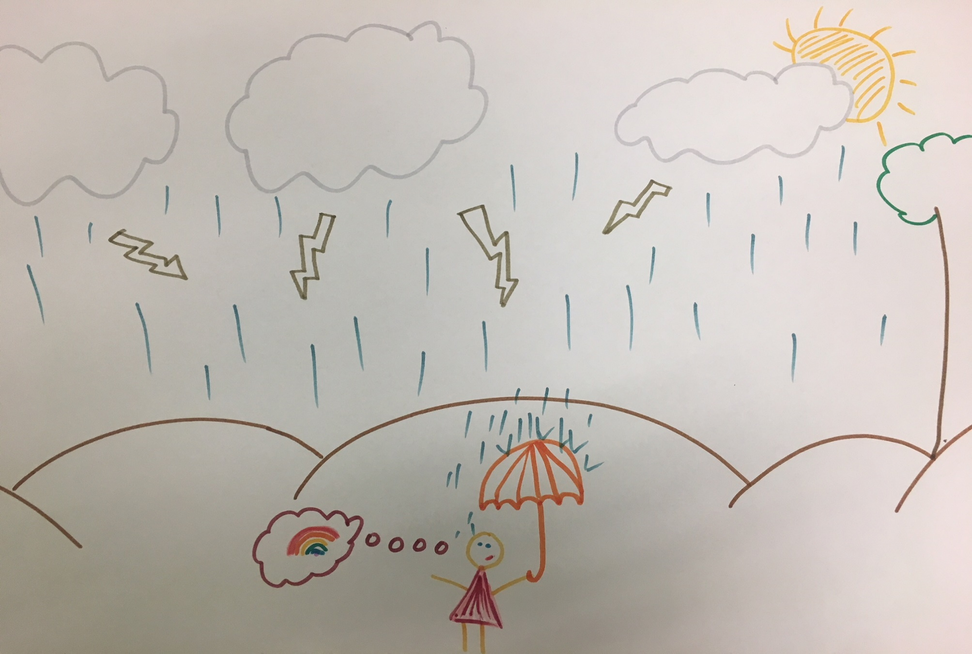
Settling the system
http://intranLettinet/brand/Pages/default.aspx

Slide 31
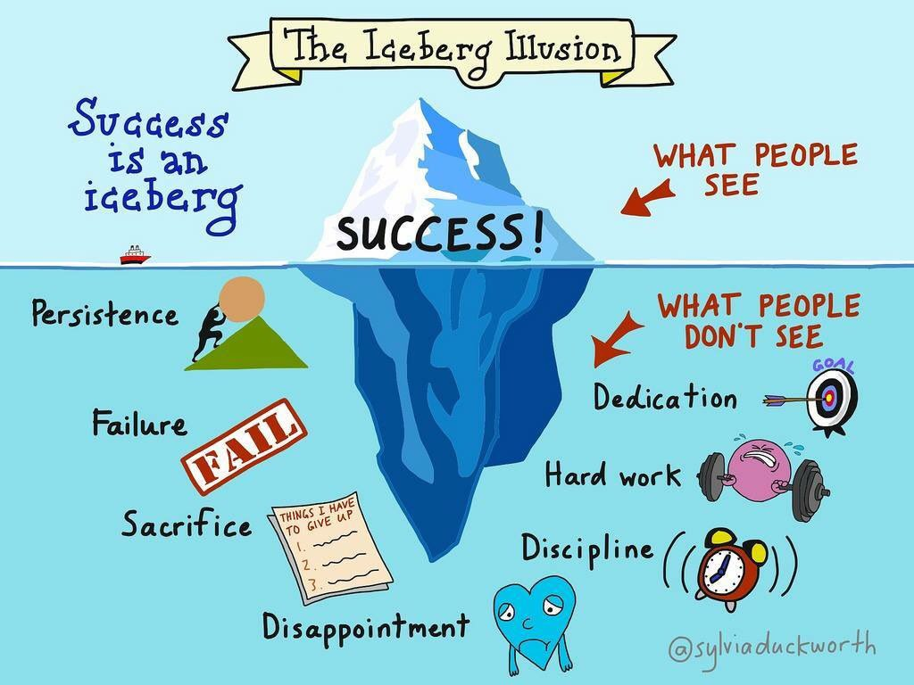
Reflecting on the process
THERAPY

Slide 32
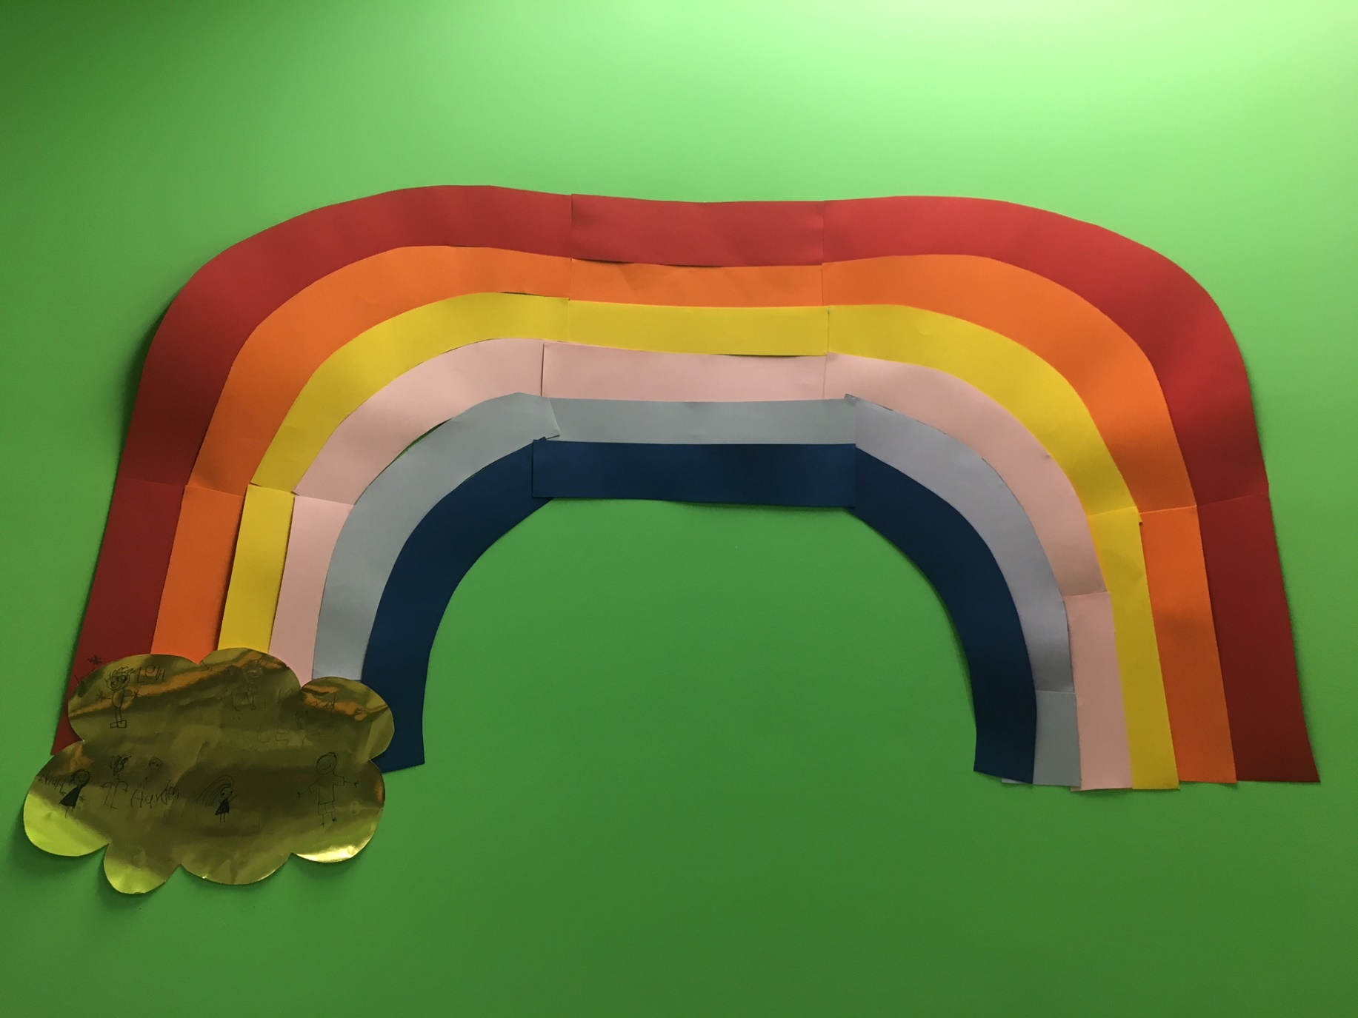

Slide 33
We don’t know what we don’t know

Slide 34
Thank you

Slide 35
Reference List
Cohen, O., & Levite, Z. (2012). High-conflict divorced couples: Combining systemic and psychodynamic perspectives.Journal of Family Therapy, 34, 387–402.
Demby, S. L. (2016). Parenting coordination: Applying clinical thinking to the management and resolution of post-divorceconflict. Journal of Clinical Psychology, 72, 458–468.
Kaduson, H.G., & Schaefer, C.E. (2006) Short Term Play Therapy for Children. New York : The Guildford Press
Lamb, M.E., (2012): Mothers, Fathers, Families, and Circumstances: Factors Affecting Children's Adjustment, Applied Developmental Science, 16:2, 98-111
Johnston, J. R., Roseby, V., & Kuehnle, K. (2009). In the name of the child: A development approach to understanding and helping children of conflicted and violent divorce. (2nd ed.). New York: Springer.
Malchiodi, C. A. (2014). Creative arts and play therapy for attachment problems . New York: Guilford Press.

Slide 36
Reference List cont..
Roseby, V., Johnston,J., et al (1997). A safe place to grow : A group treatment manual for children in conflicted, violent and separating homes. New York: Haworth Maltreatment and Trauma Press
Smyth, B. M., & Moloney, L. J. (2017). Entrenched post separation parenting disputes: The role of interparental hatred. Family Court Review, 55, 404–416.
Sori, C.F & Schnur, S. (2013) Trauma-Focused Integrated Play Therapy: An Interview With Eliana Gil, Part I The Family Journal 2014 22: 251
Van Der Kolk, B (2014) The Body Keeps the Score: Mind, Brain and Body in Healing From Trauma. Viking Penguin,.
Wallerstein, J. S., & Blakeslee, S. (1989). Second chances: Men, women & children a decade after divorce. New York: Ticknor & Fields

