Slide 1

P.E.E.R.S
Positive behaviour, Empowerment, Equality, Relationships, Safety
A collaborative approach to early intervention for family violence prevention in a school based setting.
Lee Park (Team Leader, Family Services) and Anna Ferro (Senior Child and Family Worker) at The Children’s Protection Society
Kristy Bedford (Teacher and Leader, Social and Emotional Learning at Laurimar Primary School)
Notes:
LEE
My name is Lee Park and this is Anna Ferro and we are from the Children’s Protection society in Melbourne.
This is Kristy Bedford from Laurimar primary school and we are here to talk to you about PEERS – also known as ‘Positive behaviour, Empowerment, equality, relationships and Safety
PEERS is an early intervention program for family violence prevention that was developed in collaboration between CPS and LPS.

Slide 2
acknowledgement
We would like to respectfully acknowledge the Traditional Owners of the land on which we meet and pay our respects to Elders past, present and emerging.
Notes:
LEE
Read from slide

Slide 3
OVERVIEW
About the Children’s Protection Society (CPS)
About Laurimar Primary School (LPS)
Outline & background of P.E.E.R.S
Evaluation
Children’s voices
Where to from here?
Recommendations
Notes:
LEE
Read from slide
Our presentation will also be available on the forum website and our contact details will be listed at the end of our presentation. So please don’t hesitate to contact us should you have any questions/comments.

Slide 4
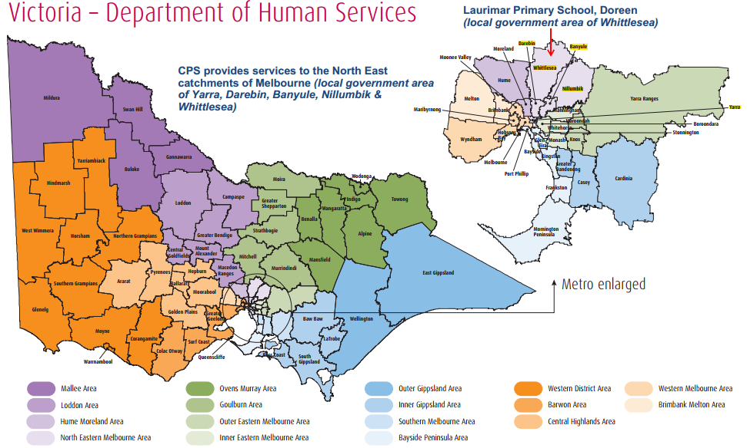
Notes:
LEE
Before we begin, just to provide some geographical context with regards to where both of our services are located
Both CPS and LPS are located in the north east catchment of Melbourne Metro – specifically in the local government area of Whittlesea
Research has shown that Family Violence is a major issue in the City of Whittlesea and this LGA has the highest rate of reported family violence in the Victoria Police Northern Division.

Slide 5
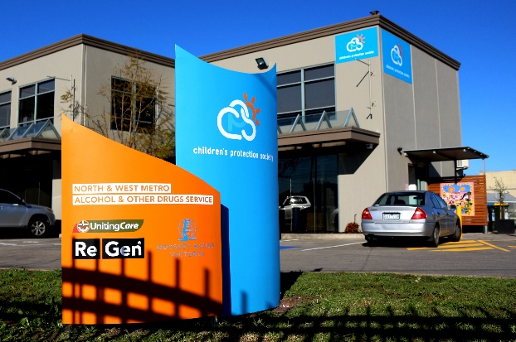
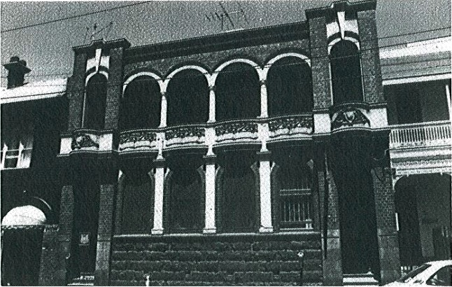
About cps
Established 1896.
Evolved from the Victorian Society for the Prevention of Cruelty to Children (VSPCC).
1920’s through to the mid 1980s responsible for investigating reports of child abuse and neglect.
Today, CPS provides a diverse, evolving range of evidence based services for vulnerable families.
Today CPS employs approximately 110 staff.
Notes:
LEE
Read from slide

Slide 6
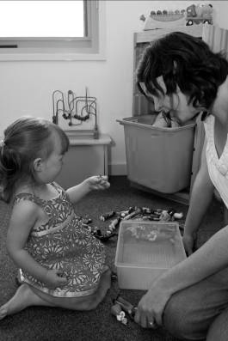
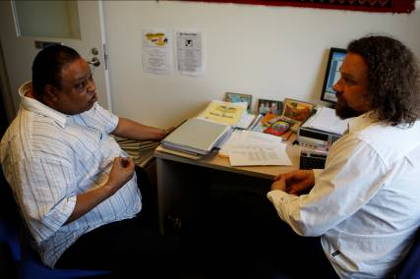
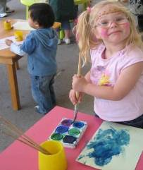

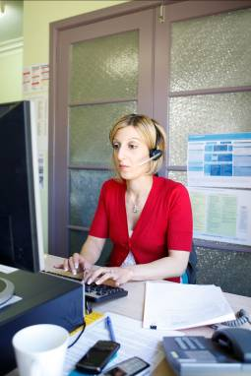
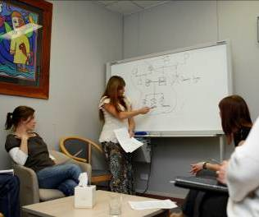
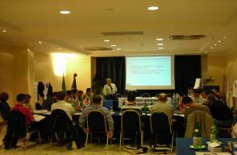
Early Years
Father Support Services
Therapeutic Services
Community Education & Training
Family Services
ChildFIRST
Notes:
LEE
CPS offers a wide range of services specialising in family violence intervention and prevention, father inclusive practice, and sexual abuse counselling and prevention, community education and training.
CPS also hosts Child FIRST (intake and triage team) for family services.
Anna and I are both from the family services team. Our team predominantly provide outreach parenting support.

Slide 7
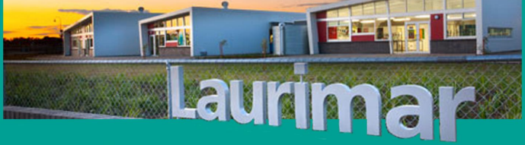
Laurimar primary school
Opened in 2009
The school has a current population of 1048 students in a rapid growth corridor
Students come from a large number of family, language cultural and religious backgrounds, with over 40 language backgrounds represented
Committed to providing a balanced, engaging, innovative and comprehensive curriculum
Notes:
KRISTY
As mentioned, Laurimar Primary school is located in the North East catchment of Whittlesea. It currently has approximately 1050 students with over 40 different language backgrounds represented. Laurimar Primary is committed to both the academic and personal growth of every student.

Slide 8
Laurimar primary school
Social-Emotional Learning (SEL) at LPS
High emphasis is placed on the development of Social Emotional Learning of every child through a dedicated team of specialist teachers
One-hour of SEL each week
Consistent use of language by classroom teachers and SEL team to reinforce positive messages
Notes:
KRISTY
To support the personal growth of every student, we have a dedicated SEL team that delivers a one hour Social and Emotional Learning program each week.The SEL teachers work together with the classroom teachers and wider school community to ensure a consistent message is communicated and to embed our whole-school approach

Slide 9
Background of P.E.E.R.S
At the time of creating the P.E.E.R.S. program in 2015:
The Royal Commission into Family Violence commenced
CPS and LPS partnered to implement an early intervention and prevention program
Pilot PEERS program implemented in early 2016 (with second year of implementation commencing Term 1 & 2, 2017)
The Royal Commission into Family Violence – recommendations mid 2016:
Mandatory implementation of Respectful Relationships Curriculum in all Victorian schools prep – year 12
Notes:
KRISTY
In 2015 The Royal Commission into Family Violence commenced. It was evident that there was a need to develop early intervention initiatives as a preventative measure in order to lessen the impact of family violence within the community.
One of the recommendations made by the Royal Commission was that in order to help us move towards a family violence-free society, "Respectful Relationships Education in schools should be enhanced and be made a mandatory part of the curriculum in every school and at all year levels....‘
It was at this time that Laurimar PS partnered with CPS to create an early intervention and prevention program called PEERS.

Slide 10
Outline of P.E.E.R.S
Aim
Design & selection of students
Facilitator roles
Program outcomes & evaluation
Topics covered
Notes:
KRISTY
The program was designed to be a primary prevention approach addressing family violence and the prevalence within the school environment and the community.
The Aim of the program was to support students to acquire relevant skills to form and maintain healthy relationships throughout their lives.
We decided on the year level we would target. We chose the Year 5 students as we felt they were mature enough to manage the content and would still have another year at the school to be positive role models for our younger students.
We then developed the outline of the program and created the lessons. The topics covered included;
-feelings, emotions and brain development
-emotional and physical safety
-healthy and unhealthy relationships
-gender and gender stereotypes
-and power and authority in relationships
These topics were influenced by the available literature regarding family violence prevention.
We wanted the lessons to be engaging and interactive. We used hands on activities, viewed video clips, worked together in small and large groupings as well as completing individual learning activities such as their reflective learning journals.
The PEERS program sessions were facilitated by a CPS staff member and an SEL teacher.
Before commencing the program Lee conducted a whole school professional development session to ensure all staff were well informed.
The PEERS program was delivered in 2016 and again in 2017.
Anna is now going to take you through the program outcomes and evaluations.

Slide 11
evaluation
Data collection:
Pre and post surveys from 150 students with a combination of closed and open questions
30 de-identified student journals
Notes:
ANNA

Slide 12
Feelings, emotional
regulation &
brain development
How much do you know about your feelings?
Notes:
ANNA

Slide 13
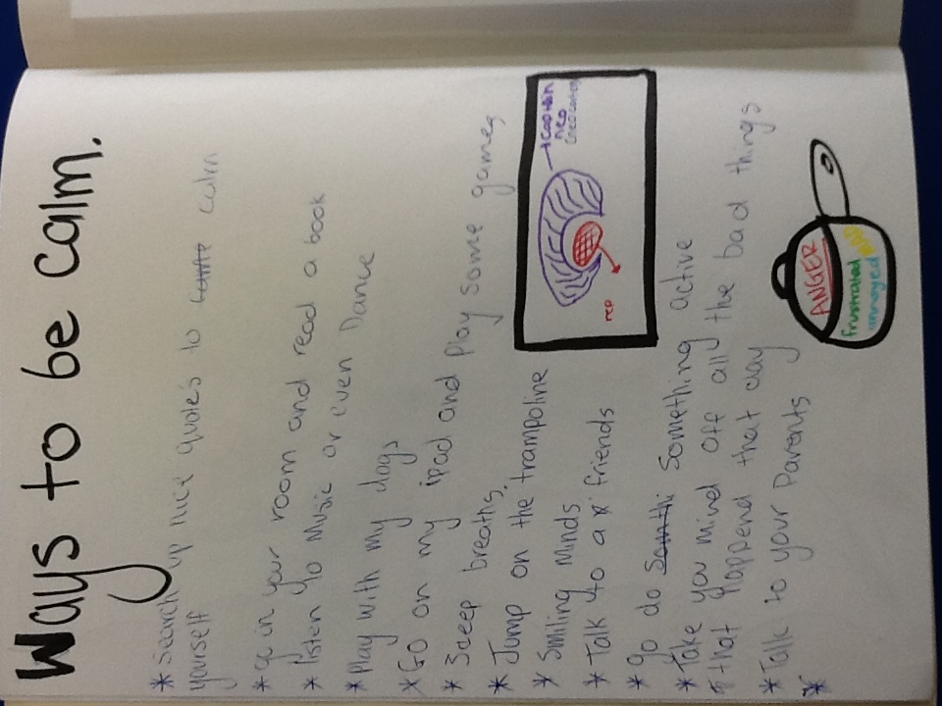
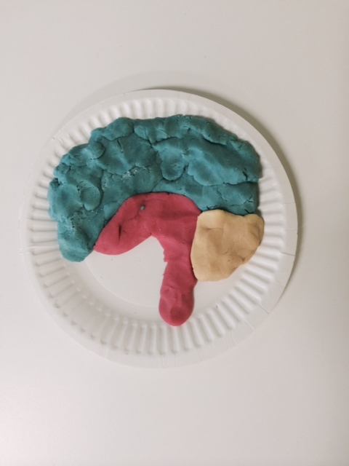
Feelings, emotional regulation & brain development
Strategies for self-regulation:
“Go for a walk; say to myself this will pass; block breathing; think of good times, count 1-10”
“Draw, lay down, take breaths, spend time with a pet, hug something”
Student journal entry
Play dough model of a brain
Notes:
ANNA

Slide 14
Emotional and physical safety
How much do you know about emotional safety?
Notes:
ANNA

Slide 15
Emotional & physical safety
How much do you know about physical safety?
Notes:
ANNA

Slide 16
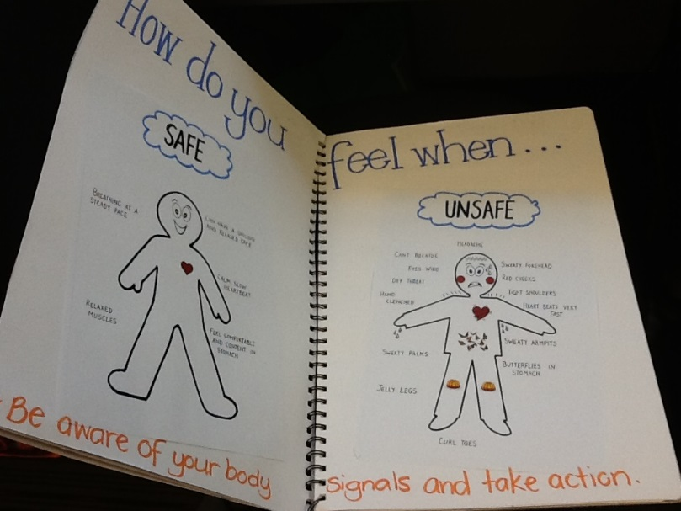
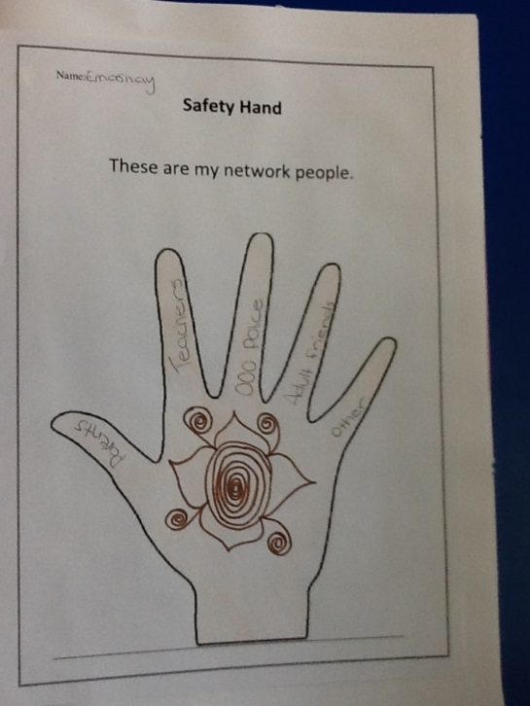
Emotional and physical safety
“Being aware of your surroundings and observing if anything seems wrong. When you're not safe, your body languages tell you that. For example, you may get sweaty palms, your heart might beat faster and you may get this uncomfortable feeling.”
“Being safe to me means making choices and decisions that will keep you from getting hurt emotionally or physically.”
Notes:
ANNA

Slide 17
Healthy and unhealthy relationships
How much do you know about managing respectful relationships with your peers?
Notes:
ANNA

Slide 18
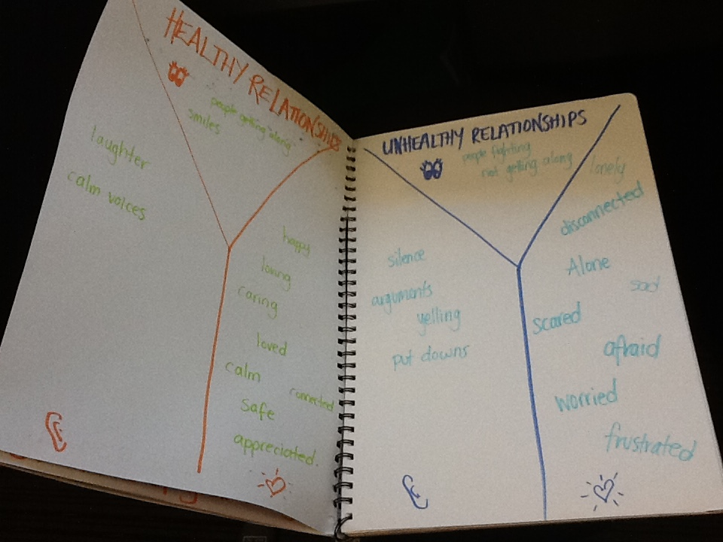
Healthy and unhealthy relationships
“Healthy - laughing with friends, talking, kindness, playing. Unhealthy - violence, saying mean things, hurting feelings”
Teacher modelled journal entry
Notes:
ANNA

Slide 19
Gender & gender stereotypes
How much do you know about gender stereotypes?
Notes:
ANNA

Slide 20
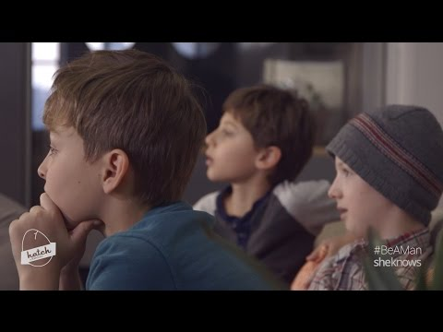
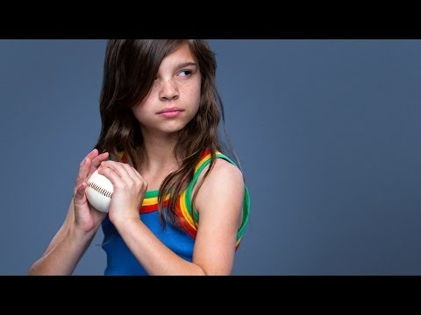
Gender & gender stereotypes
“Sports, all sports can be played by girls or boys! If you tease a person because of their gender, it's called sexist. A long time ago, girls had to stay home while the boys worked but that doesn't happen anymore. Boys and girls can clean the house, they should probably do it together.”
“Only girls can craft. In the olden days boys made girls clean and stay home. Only men are muscly and strong. Girls wear pink and purple only. Boy can only wear blue and green. Men can't cry. Girls run slow.”
#HatchKids Discuss Male Gender
Stereotypes - YouTube
Always #Like a Girl - YouTube
Notes:
ANNA

Slide 21
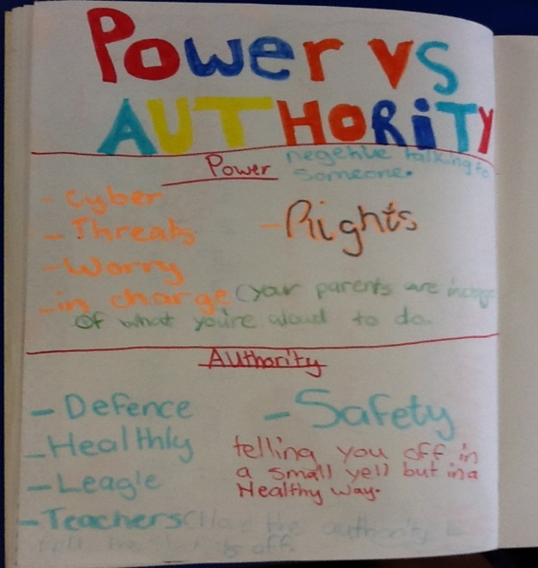
Power and authority in relationships
“Authority is for your safety; Power is forcing someone to do something else; Authority is a healthy relationship and power is an unhealthy relationship.”
“Authority when someone's telling you something for your safety; Power is when someone tells you to do something by threatening you in a bad way; power - bad and authority – good.”
Student journal entry
Notes:
ANNA

Slide 22
Family violence
How much do you know about family violence?
Notes:
ANNA

Slide 23
Children’s voices
Reflections from students:
“I will always remember that it's okay to talk to a trusted adult when I'm in trouble or in need. The most helpful was learning about everything that I had no idea about. The best part was learning about cyber safety and emotional safety. I loved learning about gender and all of the stereotypes. It was amazing to learn all this stuff. I will keep these values forever. It was awesome!”
“I liked talking about gender stereotypes. I liked watching videos. I wish we could do more colouring.”
“I liked watching clips. I didn’t liked sitting on the floor.”
Notes:
LEE
Overall the feedback we received from the students was positive.
They also provided some honest feedback regarding the desire for less ‘sitting still’ and creative activities to be included in the sessions
Here are some of their reflections…

Slide 24
Where to from here?
Further external evaluation
Focus group
Alongside LPS’ whole school approach to the delivery of the Respectful Relationships curriculum, PEERS will continue to be delivered specifically to grade five students
CPS will continue to capacity build LPS staff to deliver content
CPS (and LPS as a partner school in this project) will continue to consult with the Department of Early Education & Training to support the roll out of the Respectful Relationships curriculum
Notes:
LEE
We will explore further external evaluation
This term CPS will facilitate a focus group:
Will consist of grade 6 students who completed the program in 2016
The group feedback will be used to inform the future implementation of the program
Alongside the whole school approach to the delivery of the Respectful Relationships curriculum, PEERS will continue to be delivered to grade 5 students.
CPS will continue to capacity build LPS staff to deliver content.
CPS (and Laurimar as a partner school in the project) will continue consult with the Department of Early Education & Training to support the roll out of the Respectful Relationships curriculum.

Slide 25
recommendations
Delivery of program:
Minimal content per lesson
School commitment
Ensuring staff have time to prepare & deliver
Schools to consider:
Whole school approach, school leadership & commitment
Implementation of policies & procedures including managing disclosures
Long term cultural change
Professional development including training for staff
Team of staff to drive the content
Support for students
Explore community partnerships
Notes:
LEE
From our delivery of the PEERS program over the past two years, we have put together the following recommendations & learnings as they may assist in the scaling up of respectful relationship programs in primary schools and maximise opportunities of such programs to enhance student (teacher) outcomes and Impact.
Delivery of program:
Minimal content per lesson
School commitment
Ensuring staff have time to prepare and deliver
Schools to consider:
Whole school approach, school leadership & commitment
Implementation of policies and procedures
Long term cultural change
Professional development including training for staff
Team of staff to drive the content
Support for students
Explore community partnerships

Slide 26
Questions
Lee Park - lpark@cps.org.au
Anna Ferro – aferro@cps.org.au
Kristy Bedford - bedford.kristy.m@edumail.vic.gov.au

