Slide 1

‘Hearing the Voice of Young People and Children’
Lessons learned from the pilot project: Young Persons Family Law Advisory Group

Slide 2
Acknowledgement of Country
I would like to acknowledge that the land we meet on is the traditional lands for the Kaurna people, and that I respect their spiritual relationship with their country. I would like to acknowledge the Kaurna people as the custodians of the Adelaide Hills region and recognise that their culture and heritage is still important to the Kaurna people today.

Slide 3
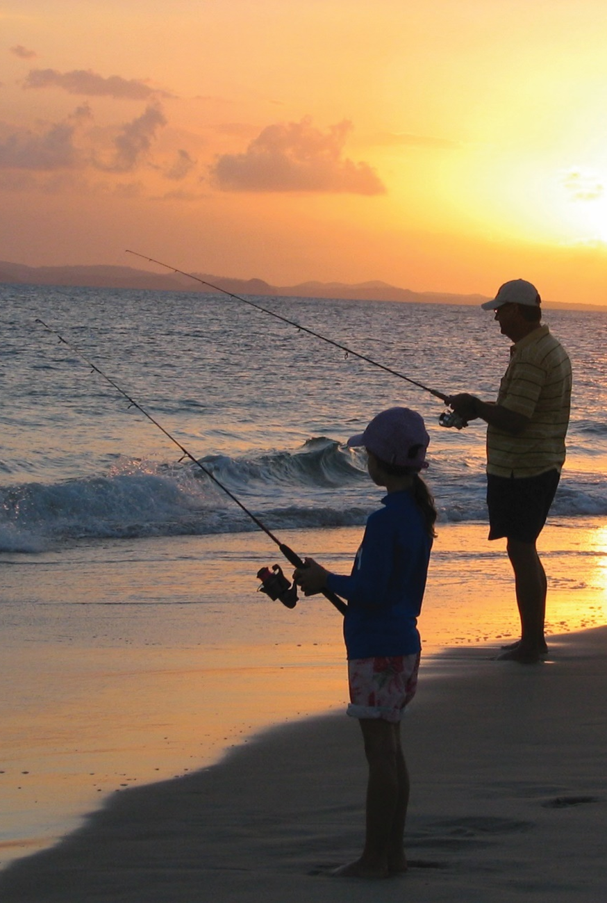
Introduction
“ Young Persons Family Law Advisory Group” – a pilot project set up through the South Australian Family Law Pathways Network in 2016
Enables a group of young people to be able to provide their feedback about their lived experience of and interactions across the broader family law system
First of its kind in Australia
Overview about the development of the YPFLAG pilot project, to give some context about how YPFLAG came into existence and the challenges and lessons learned along the way

Slide 4

Working Group
Began with a special meeting held by SAFLPN in October 2014 with Judge Cole - idea of ‘ children's council’ following ICL Report- modelled on UK experience
From this meeting, ‘Working Group’ created made up of representatives of major stakeholders first meeting held 26 February 2015
Goal of the Working Group :
  To create a pilot project in SA where a group or ‘council’ of children/young people would meet over a period of time in which to provide feedback about their lived experience of their interactions with family law system
  Use this feedback to make the system better for children/young people in the future
  Create a long term YPFLAG to provide ongoing feedback to the family law system ,including Courts, Family Relationship Centres and other such services

Slide 5

What would Pilot Project look like?
Working Group established requirements:
  Parents must have separated
  Small consumer reference group - group of young people of between 8- 12 participants
  Aged between 12- 17 years- any younger not considered workable – power imbalance and immaturity
  Parents must have finalised any outstanding Court proceedings ( and unlikely to resurface)
  Young person must have come into contact with the system in some way- eg: Court system, seen a Family Consultant, attended at a CCS, went to a Family Relationship Centre for counselling or a post separation Children's Support Group ( such as Banana Splitz), Child Inclusive Mediation or any other contact with the family law system

Slide 6
Framework- Practical Considerations
Working Group continued to meet to work out the practical considerations of the group - Where and How?
  Meet in a neutral and safe environment- possibly Court?
  Meet around 4 times a year
  Expect to take in or around 12 months to complete
  Arrange meetings at a convenient time for young people ( not school hours)
  Arrange meetings at a convenient place- Court precinct in Adelaide was considered central/easy to get to by public transport
  Young people would need to be remunerated for their time – Itunes cards were considered as best option

Slide 7
Other Crucial Considerations
Both parents must consent ( unless sole parental responsibility)
Effort to ensure the pilot group had diversity – gender, cultural, socio-economic and regional background- but acknowledged that the young people would need to be fairly articulate and confident
Ensure ‘ no further harm’- principle – therapeutic support to be provided to participants during and after YPFLAG
YPFLAG would have safety net available by having at least two other facilitators – Robin Howard and Angela Andary from Working Group volunteered to attend at meetings as support persons- available during and following YPFLAG
Ensure follow up and/or offer of therapeutic support if needed to avoid re-traumatisation
Any report generated would ensure anonymity of the participants save and except for mandatory reporting requirements

Slide 8

Ultimate Aim
Once framework established – aim was to obtain a comprehensive array of information and feedback from the participants about a variety of issues about their experience of the family law system;
Prepare an evaluation to submit to government and other peak bodies about findings on an anonymous basis – protect kids and their parents
Assist the YPFLAG participants in future skill building, such as running a meeting, taking notes/minutes and other similar important future life skills- able to provide a Certificate of Participation at conclusion of the group and a reference

Slide 9
Next stage
To recruit (and obtain parental consents) from 8-10 young people from a variety of backgrounds who were interested in providing direct feedback about their experiences of the family law system;
During recruitment period, it was identified by Working Group that funding under the SA Family Law Pathways Network was limited
Not able run a project of this type within the Pathways budget
Sought alternatives in being able to run a pilot project of this scale
In March 2016 , successful in applying to a benevolent trust, Broadley Trust for a small grant to begin the project- interested in social justice issues.
Negotiated commencing project in financial year 1 July 2017- 30 June 2017- plan to complete project over 12 month period

Slide 10

Laying the Foundation
Between March – June 2016, Working Group set up ethical standards and finalising processes
Checks & balances put into place – screening and risk assessment processes formulated – concerns of re-traumatising young people
Ethics approval established- AGD
Establishment of final processes such as confidentiality and privacy issues
Adults confirmed up to date DCSI and Police checked- working with children. Trained in Reporting Child Abuse and Neglect
Developed logo

Slide 11
Flowchart
Flowchart created to map the development of the YPFLAG
Charts how as Working Group would go about recruitment and screening processes- eg: meetings to be held at the Court precinct
Takes through the steps throughout the process
Created a timeline for bringing the group together

Slide 12
Plan for YPFLAG
Working Group developed a plan about how meetings were expected to run
The Coordinator and at least one other professional would assist in coordinating, facilitating and recording discussions.
During the meetings, the Coordinator and the support persons have used various methods to enable young people to engage in the process, including (but not limited to):
  Activities
  Games
  One on one discussions
  Group discussions
  Focus Group sessions
  Written/Oral Exercises
The Coordinator prepared a closed Facebook Page for additional engagement- ready to go once meetings began
Food ( pizza, garlic bread, fruit) and drink also provided, plus Itunes cards for remuneration

Slide 13
Establishment of Young Persons Family Law Advisory Group
With consultation of the YPFLAG Working Group, numerous methods were discussed to recruit participants, including:
  Using connections of the Working Group;
  Identifying past clients of the Working Group who have had contact with children;
  Connecting with other organisations and government departments, including DECD and Families SA;
  Word of mouth
  Limited recruitment drive

Slide 14

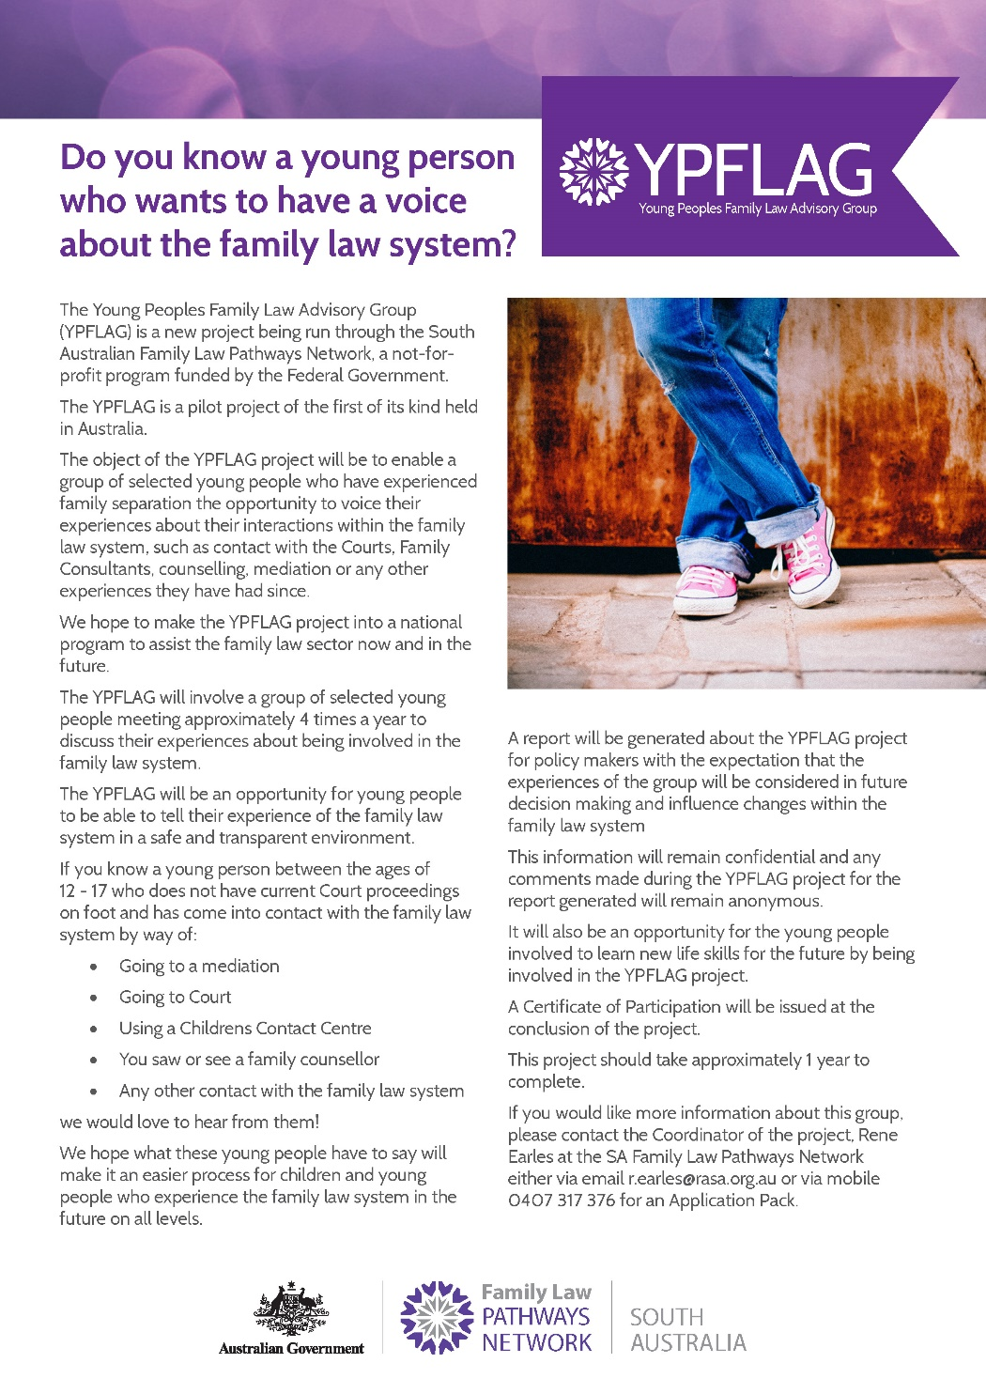

Slide 15
Initial Meeting/Interviews with Recruits
Coordinator met with each participant who wanted to be involved
Discussed expectations - not an ‘interview’ but wanted recruits to feel that their participation was important and valued
Asked series of questions- why they wanted to be involved?
Most responded with wanting to make a difference to other children
Parental consent forms were provided and signed- both parents required unless sole parental responsibility
Confidentiality and privacy of information assured save and except mandatory obligations

Slide 16

Characteristics of YPFLAG
Eventually secured 10 young people:
  Aged between 14-17 ( Year 10- 12 high school)
  Attend different schools in different socio-economic areas of Adelaide
  4 boys and 6 girls- tried to manage a gender balance
Come from a range of backgrounds- one girl lives in a regional area – organise meetings to coincide with her braces appointments
9/10 parents went to Court
Some YPFLAG are siblings- but they have had different experiences and outcomes
Some have specific safety concerns – Intervention Orders exist against one parent
Individual personalities but all very capable and able to express themselves
Notes:
Without identifying participants

Slide 17
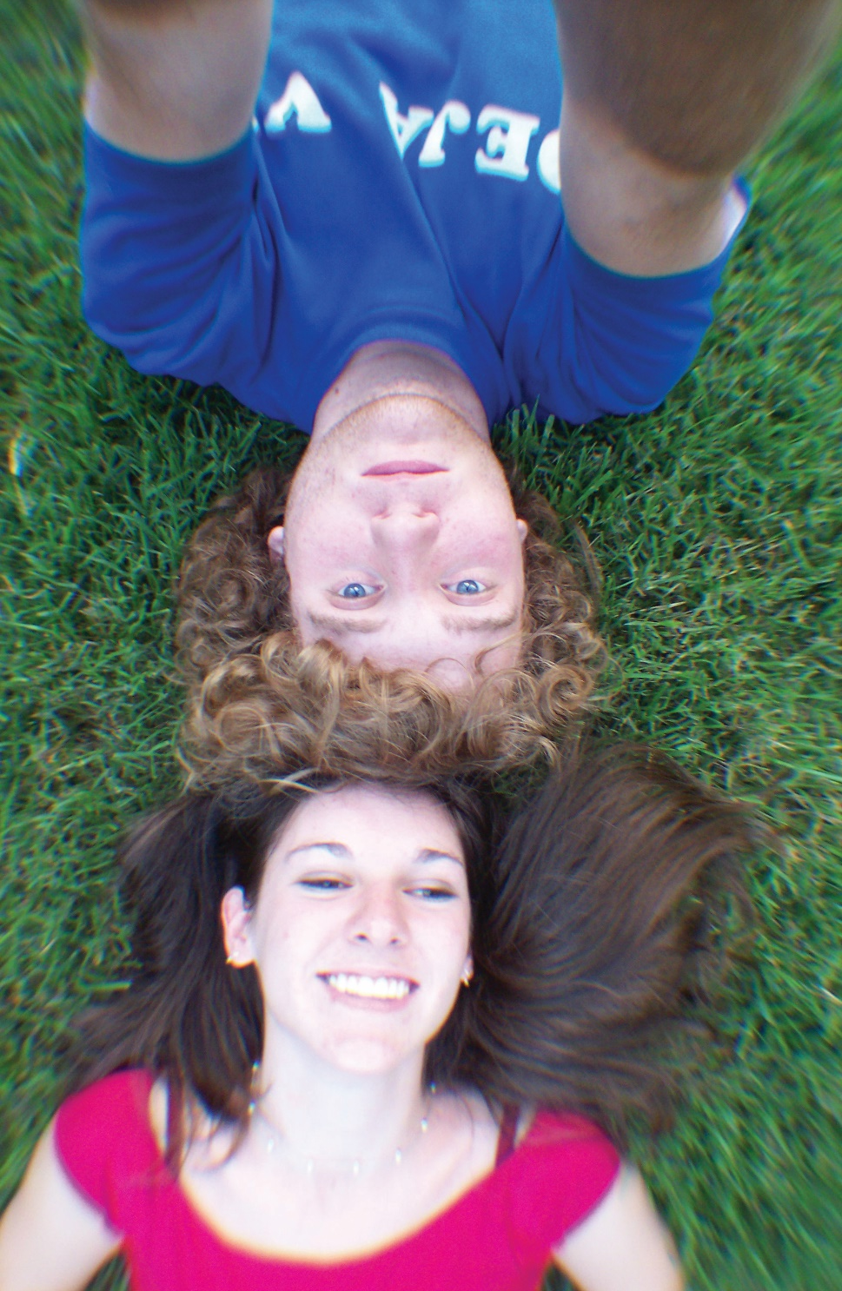
Commencement of YPFLAG
First Orientation Meeting held on 14 September 2016
All wanted to be involved as they wanted to make a difference to other children of separated parents
Discussions had about where to hold meetings- during the recruitment phase, one of the participants refused to attend at the Court
Working Group has had to reassess the project as the YPFLAG it has evolved and issues have come to light

Slide 18
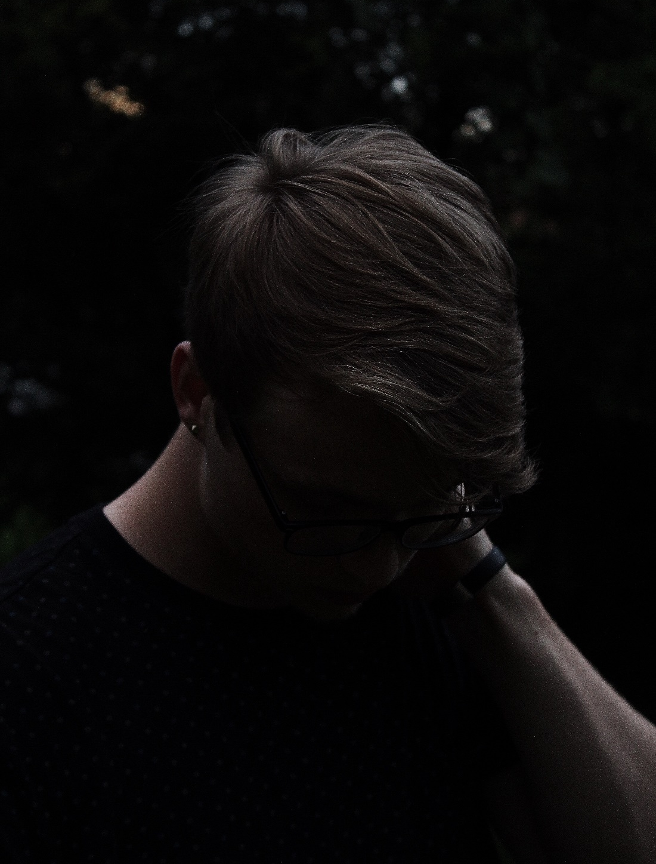
Overview of YPFLAG
Discussions
Used a narrative methodology
At Orientation Meeting, the YPFLAG created a ‘Terms of Reference’/Charter’ to reflect their goals and expectations of the project - ensure the YPFLAG themselves were ‘ drivers’ of the project and that the project was through their eyes;
Visit to the Family Law Courts Children's Area- changes made based on report
Other meetings:
  Sharing of their ‘ story’ ( if felt able to do so);
  What was the best thing? What was the worst thing? What would you recommend to a friend going through the same thing?
  Feedback on the ‘ Kids Are First’ program- need to be ‘ harder’ on parents;
  Feedback on Family Law Courts website section for kids/young people

Slide 19

Support
Emotional support has been provided to the young people during meetings, such as holding breaks where possible, offering individual discussions where necessary, allowing age appropriate language.
Robin and Angela ( facilitators) provide a great support and offer safety net for YPFLAG
Follow up to the YPFLAG meetings has been undertaken by the Coordinator by contacting the young people post the meetings to ‘check in’.

Slide 20
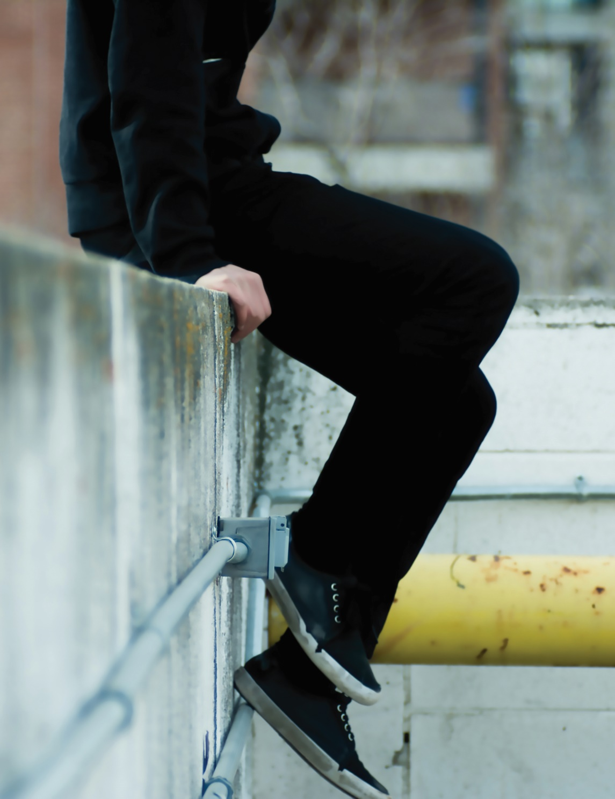
Recurring themes
Anecdotally ongoing themes from the YPFLAG to date:
  Lack of consultation with young people;
  Parents/adults failing to keep children informed about what's going on;
  Kids have offered suggestions or alternatives about how things could be improved;
  Adults see things through an ‘adult‘ lens, even when we are thinking we are thinking about children/young people;
  Sense of belonging – sense of family;
  Charter of ‘ Rights’ for children when in the Court – concept of ‘ Children's Advocate/Support Person’
  Strong emphasis on being told the ‘ truth’
  All wish to make a difference to other children going through parental separation- don’t want others to go through what they went through and want to make a difference to the system

Slide 21
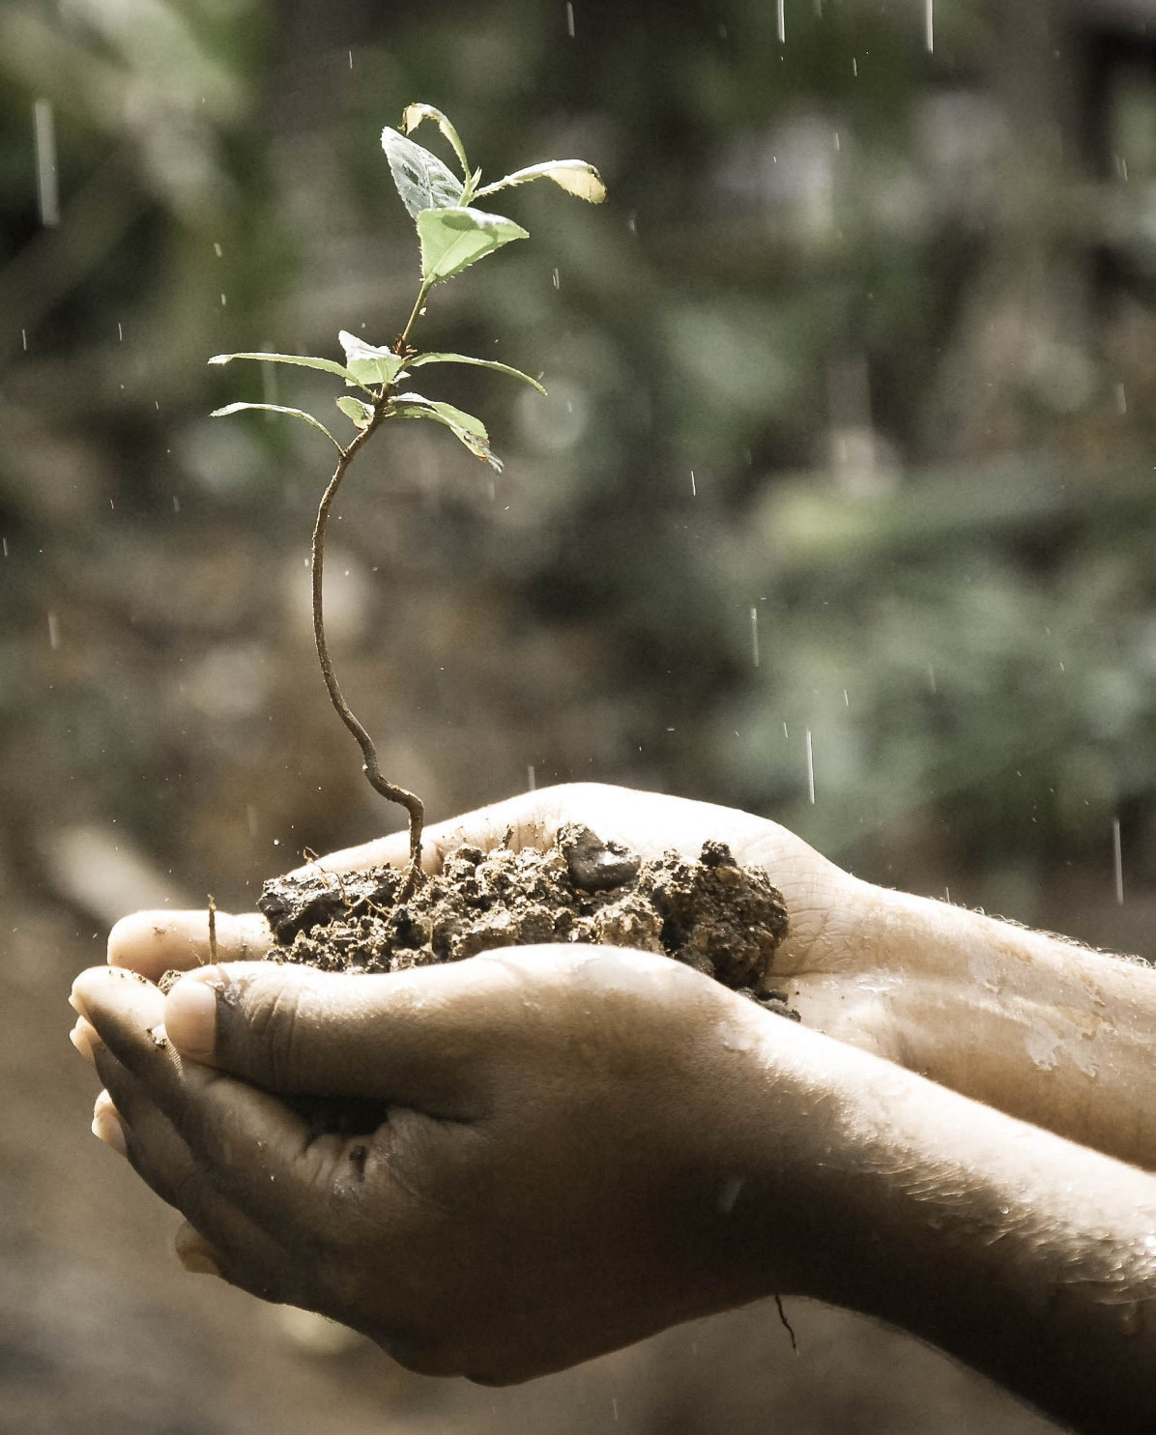
Challenges
Significant steps in which to meet our key targets with the YPFLAG project- still some work to do in which to meet all key objectives
Feeling that haven’t quite finished- not able to prepare an evaluation – extended the timeframe of project to 18 months to enable us to obtain more information
Huge learning curve in running the meetings- takes a lot of energy and expertise to engage young people

Slide 22
Lessons learned so far….
Continue to learn and grow from each session with YPFLAG
Recognise that YPFLAG participants have taken some time to relax
Taken some time to trust each other and therefore open up properly about their experiences.
Some of the information obtained from the YPFLAG, whilst very useful to date, remains limited or measured;
There are still some major themes important to explore with the YPFLAG which we think will enable us to produce a more thorough and meaningful evaluation;
Small sample size- not able to capture a large sample or diverse range of experiences;
Seen as a bit ‘ old school’;
The project has a lack of resources;
YPFLAG participants need to be fed before they are able to talk!
Tired after a long day at school- January meeting flowed well as the kids were well rested and relaxed

Slide 23
Other Challenges
In addition to a report, may be greater prospect of success in securing ongoing funding of the YPFLAG if the YPFLAG pilot is promoted to external and internal stakeholders within the family law and community sectors.
Over last few months, campaigned and lobbied major stakeholders in terms of networking and making further and stronger external relationships with government and non-government agencies who would be interested in funding YPFLAG in which to try to secure a permanent YPFLAG ( or similar ) in the future.

Slide 24
Plan until completion
Two further meetings with YPFLAG- gather as much information as possible in consultation with Working Group
Hold final meeting in December 2017 Celebration – Certificate of Participation to be received by participants
Retiring Chief Justice Diana Byrant agreed to be ambassador
Prepare a final report/evaluation – to be completed in partnership with Deakin University in January/February 2018
Promote the pilot project as much as possible
in which to secure a final funding source for YPFLAG on ongoing basis

Slide 25
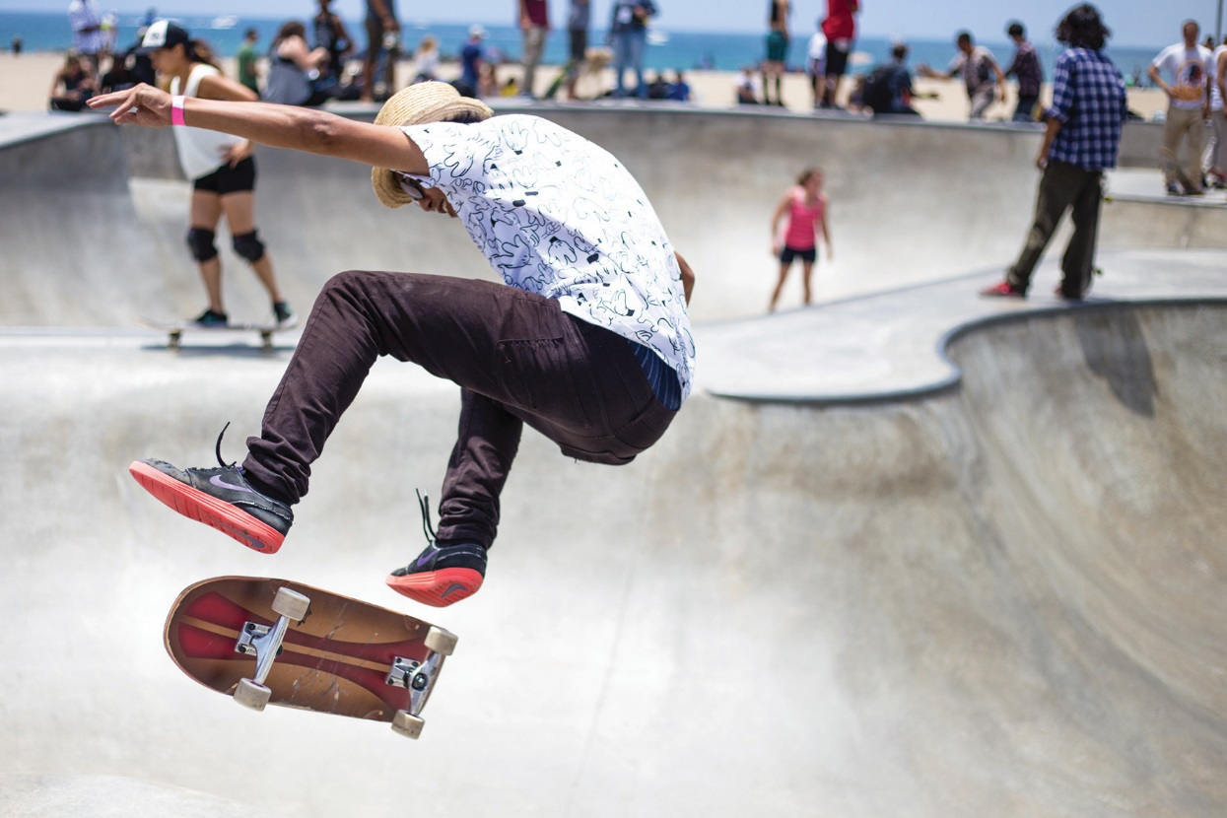
Success?
Difficult to measure
No attrition rate to date- all 10 participants have continued
Anecdotally, YPFLAG participants seemed to have improved and continue to turn up
All wanted to continue for further 6 months
All have expressed a desire to improve the lives of other children who experience parental separation
Participants who cried every time, has not cried last few meetings and keeps coming back
Have been a few incidents- have been dealt with appropriately
No complaints or negative feedback received from parents

Slide 26
Unintended Consequences
Whilst some challenges, watched the YPFLAG grow more comfortable over time
Kids have come out of their shell
Formed friendships
Feel safe- always have a safety net and feel brave enough to share some very personal information that they know wont be repeated elsewhere and that others can relate and identify with
Improved well-being – part of something that is making a real difference- no further harm principle

Slide 27
Future?
Uncertain what this will bring
Challenge to continue on without losing momentum
Look at alternative models- eg: look at collaborating with State system ( Care and Protection who have Youth Advisory Council)
Look at alternative approaches- such as on project by project or consultancy basis
Ultimately we hope that the lessons learned from the YPFLAG
What about YPFLAG themselves- most wish to continue to make a difference

Slide 28

Conclusion
Valuable exercise personally and professionally
Reinventing the wheel- no real precedent for this type of project and limited support – no large Government department funding and it has been done mostly with ‘in kind’ support
Needed on a longer term basis for the benefit of professionals in the sector and for the children who are caught up in the conflict caused by parental separation

Slide 29

Questions?

