Slide 1

Mediations with Independent Children’s Lawyers to focus on children’s needs in Hague Child Abduction Cases
Freia Carlton and Walter Ibbs
20 October 2017

Slide 2
Our Main Point
Hague mediations, with skilled Independent Children’s Lawyers (ICLs) as participants, promotes children’s interests and ought to be encouraged and supported.
Notes:
This is what we want to convince you of in this session.

Slide 3
What we will cover in this session:
Hague Child Abduction Convention - Law and Context in brief
Why we mediate alongside Court proceedings
How we mediate - Victoria Legal Aid’s Hague Mediation Model
The Role of the ICL in Hague Convention Proceedings in Australia
Case examples of ICL actions in mediation that promote children’s interests

Slide 4

Law and Context

Slide 5
Hague Child Abduction Convention – Law and Context in brief
The Convention – Context at the time of framing and context now
Objects of Convention:
To secure the prompt return of children wrongfully removed
or retained in any contracting state
To ensure rights of custody and access under the law of one
contracting state are effectively respected in the other
contracting states.

Slide 6
Law and Context (continued):
In the Italian Girls Case, the majority of the High Court point out early in the judgement that a court hearing Hague Child Abduction Cases
needs to stop its ‘natural inclination to make its own assessment about the interests of children’ - as this is a job for the courts in the country that the child was taken from.
Notes:
RCB…[2012] HCA 47
– majority quoting Eekelaar: "the Convention is concerned with reserving to the jurisdiction of the habitual residence of the child in a Contracting State the determination of rights of custody and of access. This entails preparedness on the part of each Contracting State to exercise a degree of self-denial with respect to 'its natural inclination to make its own assessment about the interests of children who are currently in its jurisdiction by investigating the facts of each individual case'[4].

Slide 7
Hague Child Abduction Convention Law Overview
Hague Child Abduction Convention introduced into Australian law by Family Law (Child Abduction) Regulations under Section 111B of the Family Law Act
Limited nature of Hague Court Proceedings (short term decision)
Elements to an application that if proven, means a court must return a child.
While there are exceptions to return – eg grave risk or intolerable situation or strong objection by child – the court has the discretion to return child anyway, having regard to the overall objects of the Convention.

Slide 8
Court must follow Hague Child Abduction Law
Elements to an application that if proven, means a court must return a child.
If an application for return is made for a child
within one year of the child’s removal or retention*; and
the removal or retention is ‘wrongful’ - because
the child is under 16 years; and
the child was habitually resident in the other country; and
the left behind parent had rights of custody in the other country; and
the child’s removal or retention was in breach of those rights of custody; and
the rights of custody were exercised (or would have been exercised if child not removed or retained)
If application is made after 1 year then left behind parent must show child is not settled in new environment.
If any element of the application is not proven then that is a complete defence and no order for return of the child can be made.
Notes:
Reg 16 Summary for slide pack – don’t need to go into all the detail

Slide 9
The Hague Child Abduction Convention Law
There are Exceptions to return of a child, but even if an exception applies, the court may still order the return of the child anyway, having regard to the objects of the Convention. (The Court is likely to impose conditions to a return order to protect the interests of a child or parent needing protection).
Exceptions to Return
Non-exercise of rights of custody
Consent or acquiescence to the removal or the retention
Grave risk that return would expose the child to physical or psychological harm or otherwise place the child in an intolerable situation
Child objects to being returned to the place of habitual residence and has attained an age and degree of maturity at which it is appropriate to take account of the child’s views
Not permitted by the fundamental principles of the state relating to the protection of human rights and fundamental freedoms

Slide 10
Best Interests of Child Not Paramount in Hague Convention Proceedings
Australian parenting cases are decided on the basis that a court must regard the best interests of the child as the paramount consideration (section 60CA Family Law Act).
Section 60CA does not apply to Hague Child Abduction proceedings.

Slide 11
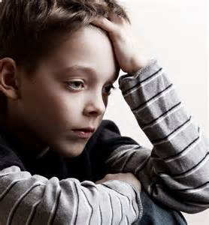
Can the Court consider the best interests of the child at all in Hague proceedings?
In certain circumstances, yes, noting it is not the paramount consideration.

Slide 12
Circumstances in which the Court can take into account the best interests of the child in Hague proceedings
After the court finds an exception to return has been made out and is then deciding whether or not to return the child anyway.
In the making of conditions for return of a child (note the court can make conditions whether or not an exception to return has been made out)
If the court orders a family report, a family consultant can report on matters that relate to the care, welfare and development of the child
If the Court appoints an ICL, the ICL must have regard to the best interests of the child when acting in Hague proceedings
Notes:
So there are ways in which the needs and interests of children can be taken into account and these can be explored through mediation

Slide 13


Hague Mediation

Slide 14
Mediation of Hague Cases at Victoria Legal Aid
Hague Court proceedings have commenced in the Family Court of Australia in Melbourne
A party to proceedings has grant of legal aid (generally an appointed Independent Children’s Lawyer) who attends mediation
The costs of mediation are free to the parties (noting that if a privately funded lawyer attends that is a cost to that party)
We work within court timeframes – no delay
We encourage lawyers for parents to attend
Lawyers for the State Central Authority support mediation but do not attend
Notes:
Context is entrenched conflict, polarised positions, likely failed negotiations before we attempt mediation.

Slide 15
Why we mediate Hague Cases at Victoria Legal Aid
To help parents address deep conflict and focus on their children:
Look beyond immediate Hague application – what will be best for their children? Attempt to prevent ongoing conflict/litigation
Minimise harm to children
Assist with agreement for time & communication between children and LBP
2. To help resolve the conflict by exploring multiple options and outcomes
To best use or save court time
To maintain and restore dignity with opportunities for restorative justice and insight for future parenting

Slide 16
Examples of Soft Landing Conditions
Payment of return airfare for taking parent as well as child
Modest amount of money to cover immediate needs for accommodation, food for taking parent and children on return or provision of accommodation
Left Behind Parent not to be involved in criminal prosecution of taking parent on return
Child receives counselling on return
Child returns to former school
Parents agree to interim parenting arrangements and enforceable orders until court in other country makes decision

Slide 17

How Do We Mediate?

Slide 18
Victoria Legal Aid’s Hague Mediation process
Set up session times quickly (on dates after release of any family report)
Agreement to mediate – attach confidentiality and exceptions
Risk assessment and preparation interview– capacity to negotiate, safety issues
Participants – ICL (if one), parents (perhaps with lawyers). (Not SCA lawyers)
Use available technology (eg Skype)
Interpreters where necessary
International time differences taken into account
Court timeframes respected
3 sessions over approx. 7-10 days

Slide 19
FDRS Hague Mediation Conference– 3 x 4 hrs
Two mediators (one male, one female, one social science background, one legal – in one case one Australian, one Japanese).
First Session: Purpose of mediation, child-focused lens, address fears. Seek agreement on communication/time for LBP and child; give homework for parents to consider practical issues relating to return (if ordered) or non-return
Second Session: Working through specifics of options (issues such as criminal prosecution, visas, passports, funds, flight costs, evidence)
Third Session: Details of any agreement, next steps

Slide 20

Role of the Independent Children’s Lawyer

Slide 21
Role of the ICL in Hague Convention Proceedings
Firstly, note ‘exceptional circumstances’ for appointment under s68L
s68LA(3) of Family Law Act sets out role (case law too)
Best No 2 (State Central Authority & Best (2) [2012] FamCA 511
RCB (Italian Girls case in the High Court of Australia) [2012] HCA 47

Slide 22
Role of the ICL in Hague Convention Proceedings - summary
Forms an independent view based on evidence and makes submissions of courses of action a court may take, of what is in the best interests of the child (within the confines of the Hague proceedings)
Acts in relation to the proceeding in what the ICL believes to be the best interests of the child (within the confines of the Hague proceedings)
ICL is not there to propose what ultimate outcome may be in the best interests of the child – but rather consider the best interests of the child in concluding the Hague application.
Role is best interests not direct representation (Italian girls case in High court)
Best interests of the child is not the paramount consideration
Notes:
Has the role, duties and obligations of an ICL in domestic proceedings but they must understand the context in which they are working and respect the Hague Child Abduction law framework.

Slide 23
ICL Key role (before, during and after mediation)
Has the value base and role to consider the best interests of the child – considers the impact on the child of any proposal
Has influence and authority to take measures that promote children’s interests:
As independent lawyer appointed at request of court
Has access to information in Court and outside of court
As a specialist in Hague Child Abduction Proceedings
By presenting legal information neutrally and in a way that reassures
As a person who has met the children
Notes:
I

Slide 24
ICL Key Role – Before, During and After Mediation (continued)
3. Keeps the matter on track with skillful case management and communication
Encourages participation in voluntary mediation
Researches each countries legal systems and government functions (relevant to some defences ‘rights of custody’, relocation law, visa requirements, likely criminal prosecutions).
Communicates with lawyers for Central Authority (and/or delegated SCA) regarding arrangements for children and carers in other country

Slide 25
ICL Key Role – Before, During and After Mediation
skillful case management and communication (cont)
d) Liaises with Judge, through Judge’s Associate, regarding progress of mediation in general terms while preserving confidentiality, having matter listed to seek interim or other orders
e) Requests Judicial Communication with Hague Network Judge and/or other Judges in other country – this can be about enforcement of orders in the other country
f) Assists parties to follow interim agreements about skype, telephone or face to face time
4. Follows up on translating a mediation agreement into enforceable orders in court

Slide 26


Does Hague Child-Inclusive Practice Mediation work?

Slide 27
ICL Making a Difference in Hague Mediation
Canadian case*
Mother came to Australia with two young children aged 7 and 5. Retained them following a holiday. In breach of Canadian week-about shared care orders. These orders were on appeal by the mother. Hague Proceedings commenced on behalf of left behind father.
A Family Consultant and Psychiatric assessment of the 7 year old indicated the child was at risk of suicide if he were to be separated from his mother.
The mother had been denied entry to Canada and had no valid visa to return.
Children could still be ordered to return as ‘Grave risk exception’ was contestable with evidence that the father and counsellors could provide emotional support to children in Canada

Slide 28
Canadian case*
During mediation sessions the ICL
Researched immigration law and took steps that enabled the mother to re-enter Canada after she was denied entry.
Arranged for the psychiatrist to be available during mediation so both parents could hear about suicide risk of child
Focused on children’s needs at all stages of mediation

Slide 29
Canadian case*
Outcome: Agreement on conditions for return that protected children
Father agreed to a delayed return of children until mother obtained a special humanitarian visa so she could return with children
Non-prosecution of mother so no arrest and imprisonment
Shared care pending Canadian court determination
Orders for return to be explained to children by psychiatrist

Slide 30
ICL Making a Difference in Hague Mediation
Mauritius case*
Primary carer mother took 9 year old boy to Australia without father’s consent. She also came with two older children – no wrongful removal for the older children as their father consented.
Mother had lost an initial legal hearing in which she had argued that the father of the 9 year old had no ‘rights of custody’.
The mother was hoping to argue an exception to return on the basis of grave risk or intolerable harm for the child (mother alleged family violence)

Slide 31
Mauritius case*
At mediation, the ICL
Discussed conversation with the child including that he was afraid of separation from mother.
Facilitated SKYPE time between child and father – father reported back that he could see his son ‘was happy’.
Focused on the child’s needs at all stages of mediation
Explained how agreements could be made into enforceable orders

Slide 32
Mauritius case*
Outcome: Agreement on Hague return issue and a parenting plan to be enforced in both Australia and Mauritius
Parents reached agreement to end all court proceedings
Boy to remain in Australia living with his mother (and siblings) and to spend holiday time twice a year with the father.

Slide 33
ICL Making a Difference in Hague Mediation
NZ case
Primary carer mother took 5 children – aged between 2 and 14 years to Australia without their father’s consent.
Proceedings were on foot in the NZ Family Court.
NZ interim orders were in place for the father to have supervised time at a NZ contact centre with the children.
The father was alleged to have used violence and abused drugs and alcohol.
In the NZ court proceedings a Lawyer for the Child had been appointed.

Slide 34
NZ case*
At mediation, the ICL
Shared that she had been in communication with the Lawyer for the Child in NZ
Listened to the mother’s proposal that the children live with her in Australia and that she send the children to NZ each school holidays for unsupervised time with the father – (2 year old for single days only)
Listened to the father make demands in relation to the proposed unsupervised time (to include the 2 year old with whom he had never spent overnight time).
Indicated that she could not support any agreement for the children to remain in Australia with unsupervised time with the father in NZ.
NZ case – Maori family – extraordinary mother. During mediation the ICL indicated that she could not support an agreement between the parents that potentially placed 5 children –especially a 2 year old - at risk. The primary carer mother was seeking the left behind father’s consent to remain in Australia with the children with him having extensive unsupervised time with the children in NZ during school holidays. The ICL had obtained information from the NZ Child’s Lawyer (in relation to previous proceedings in NZ) that indicated that the father had a history of family violence and drug misuse. Furthermore the father had never spent any overnight time with the youngest child. The ICL indicated that she would not support that outcome in Court. The mother voluntarily returned to NZ with the children (in a different town to the father).

Slide 35
NZ case*
Outcome: The mother voluntarily returned to NZ with the children (moving to a different town from the father).

Slide 36
ICL Making a Difference in Hague Mediation
Thailand case
Mother took two boys aged 10 and 12 from Thailand to Australia without the father’s consent
Parenting orders in Thailand
The mother alleged a history of family violence and failure by the Thai authorities to protect her
The father denied any abusive behavior toward the mother and children.

Slide 37
Thailand case*
At mediation, the ICL
Shared knowledge of Hague Case law and practice with both parties lawyers
Shared information about her meeting with the boys and talked about their interests and personalities – refocusing to children
Discussed support from experienced Child Psychologist in Thailand
Helped formulate agreed Skype time between the boys and their father

Slide 38
Thailand case*
After Mediation
ICL renegotiated SKYPE time between the father and children – Kept it on track after it went a bit awry
Court hearing with evidence on family violence
Well presented submissions in Court
ICL firm on conditions attaching to return, if return ordered
Did mediation with an ICL contribute to a better outcome for the children?

Slide 39
Thailand case*
Outcome: Court made order for return of children with numerous conditions for the protection of the children and their mother
The children were to be returned on conditions that included:
Enforceable orders being made in Thailand before return
A discharge of the sole custody order the father had obtained in Thailand after the mother took the children
An interim protection order in place for the mother
Discharge of the arrest warrant for the mother
Written confirmation from Thai authorities that the mother would not be prosecuted
Therapy for the children and the family on return

Slide 40
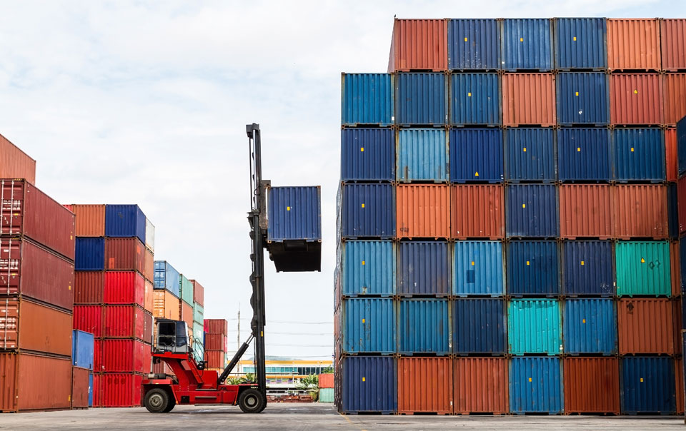

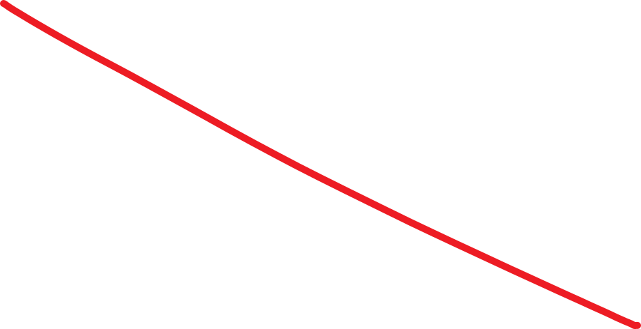
Say NO to Kids as Cargo

Slide 41

Questions & Contacts
Freia.Carlton@vla.vic.gov.au
Walter.Ibbs@vla.vic.gov.au

Slide 42


