Slide 1
The Ripple Effect:
Rebuilding the Parent Child Relationship.
Lucy Allen
Uniting, The Anchor,
Unifam Counselling and Mediation

Slide 2
Parental Conflict and its impact
  There are two major predictors of children’s adjustment to family breakdown that are consistently identified in literature:
  Exposure to inter-parental conflict
  The quality of the parent-child relationship
  J.McIntosh, 2003

Slide 3
The Parent Child Relationship
Research shows that parent child connectedness is a “super protective factor” against adverse outcomes in adolescence.
PCC is the single strongest indicator that an adolescent will reach adulthood without experiencing teen pregnancy, violence, without becoming addicted to drugs or tobacco and without dropping out of high school.
Parent-Child Connectedness: Implications for Research, Interventions and Positive Impacts on Adolescent Health, 2004, The Education Training Research Associates (ETR)
The ETR define PCC as “ Seeing the interaction between the parents and children not just as individuals but as part of an on-going dynamic relationship.”

Slide 4
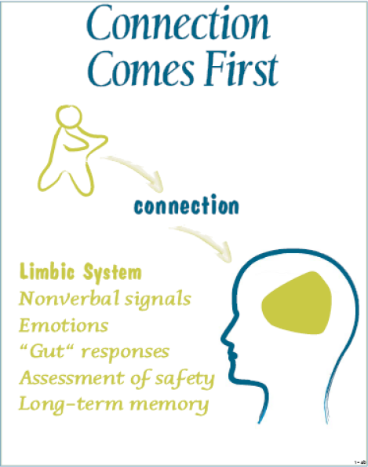
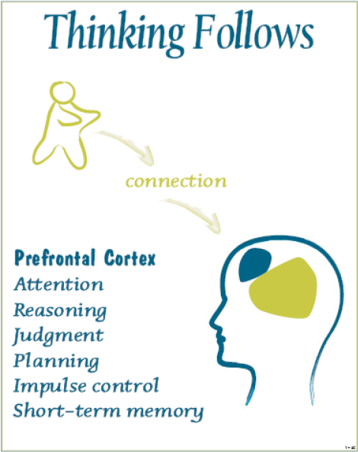
Connection is Vital

Slide 5

Parental Attunement

Slide 6

Quality vs Quantity

Slide 7
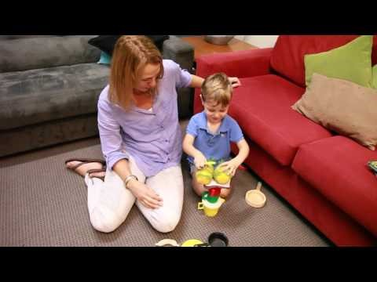
SPECIAL TIME
Special time is a framework in which a child can enjoy their parents’ focused attention - it’s a practical and flexible way for parents to deliver their attention.

Slide 8
How to offer Special Time
Defined period of time
No interruptions.
Eye contact, affection, and warm comments and tone.
Child in charge of their relationship.
The parent follows the child’s lead.
The parent demonstrates affection, interest and approval through their interaction with their child.
No advice or teaching.
There’s a beginning and an end to Special Time.

Slide 9
Building Trust
When Special Time is given on a regular basis the child may build a deeper trust in their parent.
Children may begin to show their parents more of themselves, how they see the world and how they feel.
Parents pay attention to any feelings that come up for their child during Special Time or after it ends with warmth.

Slide 10
Adolescents
Time together on their terms…..
They decide what they want to do with the parent.
Parents prioritise time together and keep appointments.
Lower intensity.
Parents make themselves available.
Parental complaints are off limits during this one on one time.

Slide 11
Don’t….
Don’t give into the temptation to direct play or offer ideas.
Don’t give your child advice
Don’t multitask
Don’t use Special Time as a reward

Slide 12
What Parents can expect
Children will absorb their parents caring and will decide how to use it in their own time and way.
Parents may be tested.
Children may explore new territory
Children may show parents issues of importance and bring up a wide variety of issues
Children may show an increasing attachment to their parent
Old difficulties children have may reappear as trust builds –increased safety in the relationship may lead a child to bring up unfinished business to be resolved.

Slide 13
How can I use this in my practice?
Family Dispute Resolution
As a recommendation in a CIP feedback to parents.
Possible follow up appointment with a Child Consultant / Therapist to support parents to implement Special Time.
Mediators can promote Special Time when there are disputes around time/ contact arrangements.
Provide parents with resources and encourage them to try it out.
Connect with a professional who can support them to implement Special Time.
Provide a referral .

Slide 14
Supporting Parents to Implement Special Time

Slide 15
Supporting Parents to Implement Special Time

Slide 16


Resources

Slide 17
References
Berry Brazelton, T., Greenspan, S. (2000) The Irreducible Needs of Children, What Every Child Must Have to Grow, Learn and Flourish. Perseus Publishing.
N. Lezin, L. Rolleri, S. Bean, J. Taylor, (2004) Parent-Child Connectedness Implications for Research, Interventions and Positive Impacts on Adolescent Health. ETR Associates.
McIntosh, J., (2003). Enduring Conflict in Parental Separation: Pathways of Impact on Child Development, Journal of Family Studies, Vol 9, No 1, April 2003, pp63-80.
McIntosh, J., Burke, S., Dour, N., Gridley, H. (2009) Parenting After Separation, The Australian Psychological Society.
Maloney, L & McInstosh, J , (2004). “Child-Responsive Practices in Australian Family Law: Past Problems and Future Directions,” Journal of Family Studies, 10(1): pp71-86.
O’Hanlon, A., Patterson, A., Parham, J.(2007). Partners in Prevention Mental Health and General Practice. Monograph 2: Managing the Impact of Separation and Divorce on Children, The Australian Psychological Society, Auseinet.
Siegel, D., Haertzell, M., (2003) Parenting from the Inside Out, Penguin, New York.
Dr Dan Siegel Presenting a Hand Model of the Brain: https://m.youtube.com/watch?v=gm9CIJ74Oxw
Hand in Hand Parenting by Connection: https://www.handinhandparenting.org/?s=Special+Time
“Our Playtime”: https://www.cela.org.au/2017/08/31/playtime-five-minute-video-change-families-forever/
Watch, Wait Wonder: http://www.watchwaitwonderdownunder.com/

Slide 18
Thank you

